Slide 1

Excited States and Nonadiabatic Dynamics
CyberTraining School/Workshop 2023
Alexey Akimov
University at Buffalo, SUNY
June 11, 2023

Slide 2
Basic Concepts and Terminology of Nonadiabatic Dynamics

Slide 3
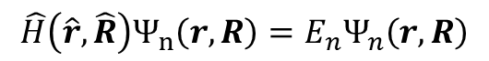
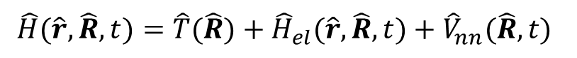
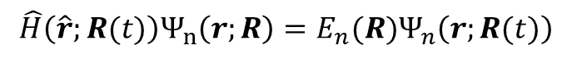
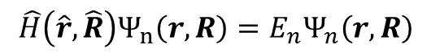
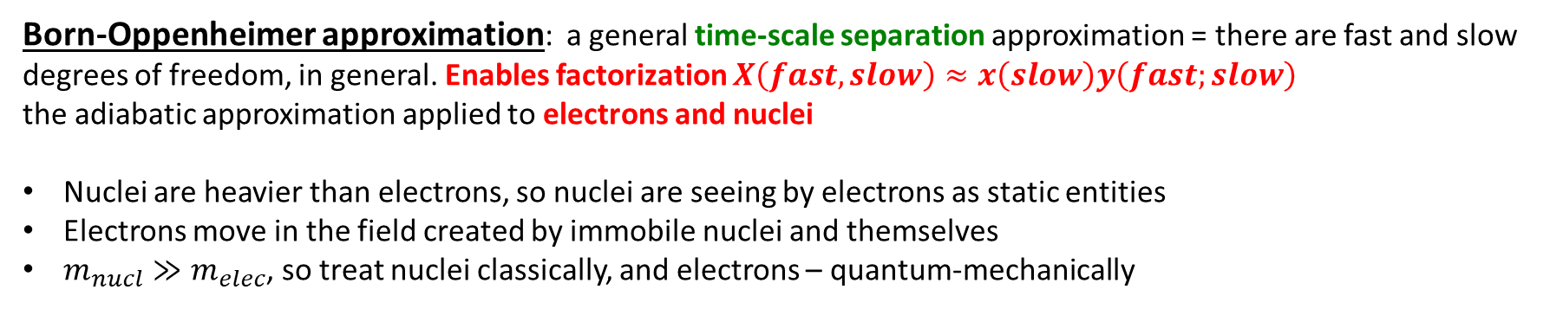
Born-Oppenheimer Approximation
$$\hat{H}(\hat{r},\hat{R},t)=\hat{T}(\hat{R})+{\hat{H}}_{el}(\hat{r},\hat{R},t)+{\hat{V}}_{nn}(\hat{R}, t)$$
$$\hat{H}\left(\hat{r},\hat{R}\right)Ψ_{n}\left(r,R\right)=E_{n}Ψ_{n}\left(r,R\right)$$
Includes el-el and el-nucl interactions
This is an electron-nuclear (vibronic) Hamiltonian
This is an electron-nuclear (vibronic) wavefunction
Born-Oppenheimer approximation: a general time-scale separation approximation = there are fast and slow degrees of freedom, in general. Enables factorization $X\left(fast, slow\right)≈x\left(slow\right)y\left(fast;slow\right)$
the adiabatic approximation applied to electrons and nuclei
Nuclei are heavier than electrons, so nuclei are seeing by electrons as static entities
Electrons move in the field created by immobile nuclei and themselves
$m_{nucl}≫m_{elec}$, so treat nuclei classically, and electrons – quantum-mechanically
$$\hat{H}\left(\hat{r},\hat{R}\right)Ψ_{n}\left(r,R\right)=E_{n}Ψ_{n}\left(r,R\right)$$
$$\hat{H}\left(\hat{r};R(t)\right)Ψ_{n}\left(r;R\right)=E_{n}(R)Ψ_{n}\left(r;R(t)\right)$$
BO approximation
Coordinates of nuclei are parameters
Energy – is a function of these parameters: potential energy surface
Coordinates of nuclei are the dynamical variables
Energy - is a number

Slide 4
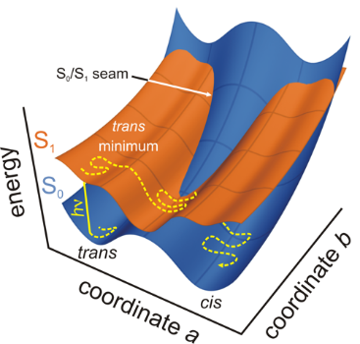
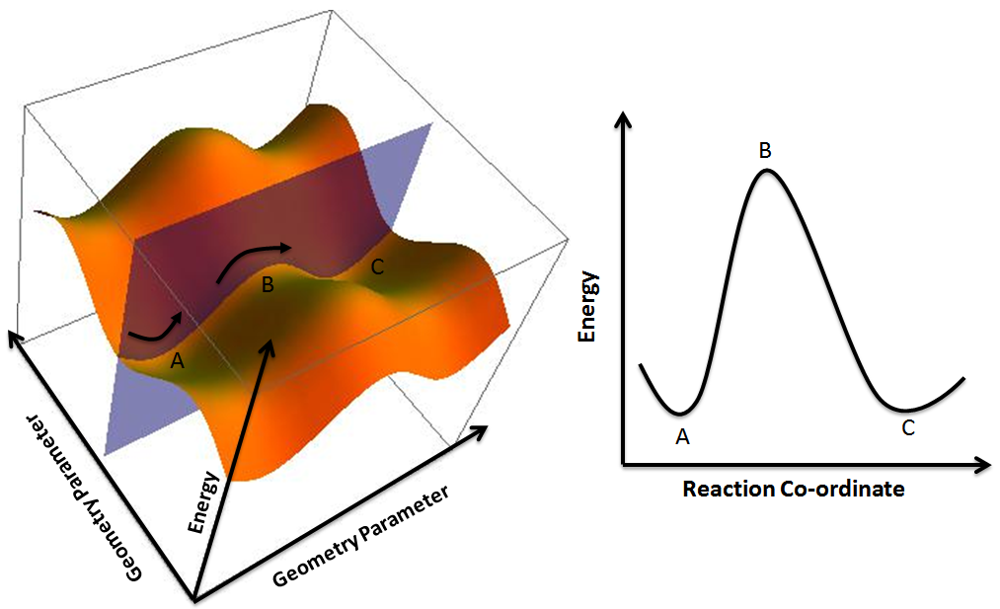
Potential energy surfaces (PES)
$$E_{n}\left(R\right)={\left\langle Ψ_{n}\left(r,R\right) | {\hat{H}}_{el}\left(r,R\right) | Ψ_{n}\left(r,R\right)\right\rangle }_{r}+V_{nn}(R)$$
Energy of a given state as a function of nuclear coordinates
Multidimensional, but one is often interested in lower-dimensional cuts (profiles)
Topology: minima, maxima, barriers, saddle points
Reaction coordinate – a collective transformation of all atoms
Present only as a consequence of the BO approximation
https://www.google.com/url?sa=i&url=https%3A%2F%2Fcommons.wikimedia.org%2Fwiki%2FFile%3APotential_Energy_Surface_and_Corresponding_Reaction_Coordinate_Diagram.png&psig=AOvVaw3JUnkD5y1MiNgWew9eCb6c&ust=1588191360500000&source=images&cd=vfe&ved=0CAIQjRxqFwoTCJj3nob4i-kCFQAAAAAdAAAAABAg
https://www.google.com/url?sa=i&url=http%3A%2F%2Fwwwuser.gwdg.de%2F~ggroenh%2Fresearch.html&psig=AOvVaw3JUnkD5y1MiNgWew9eCb6c&ust=1588191360500000&source=images&cd=vfe&ved=0CAIQjRxqFwoTCJj3nob4i-kCFQAAAAAdAAAAABAa

Slide 5
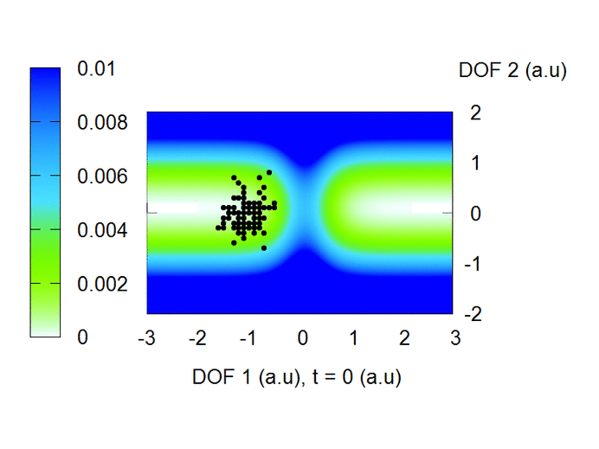
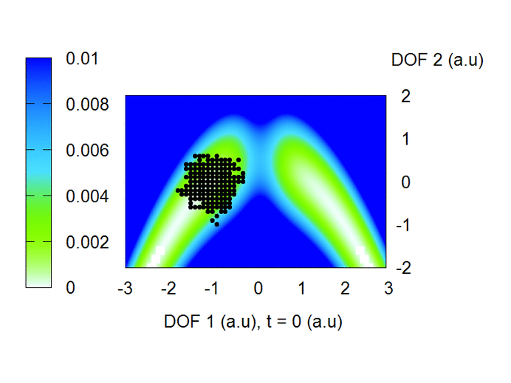
Potential energy surfaces define the reactive dynamics
Credit: Brendan Smith

Slide 6
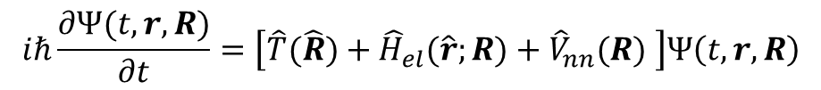
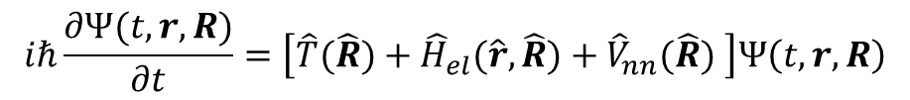
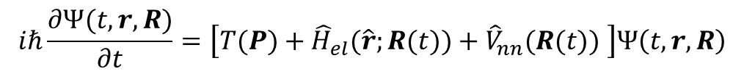
Tiers of approximation to the molecular Hamiltonian
Disregard the form of the wavefunction for now
Everything is operators!
Exact TD-SE
$$iℏ\frac{∂Ψ(t,r,R)}{∂t}=\left[\hat{T}(\hat{R})+{\hat{H}}_{el}(\hat{r},\hat{R})+{\hat{V}}_{nn}(\hat{R}) \right]Ψ\left(t, r,R\right)$$
Electronic DOFs are still operators (quantum)
$$iℏ\frac{∂Ψ(t,r,R)}{∂t}=\left[\hat{T}(\hat{R})+{\hat{H}}_{el}(\hat{r};R)+{\hat{V}}_{nn}(R) \right]Ψ\left(t, r,R\right)$$
TD-SE with the BO
Nuclear DOFs are variables – could be independent (quantum) or could be time-dependent (classical path)
In general, we still have nuclear kinetic energy operator (for quantum nuclei)
TD-SE with the classical path approximation (CPA)
$$iℏ\frac{∂Ψ(t,r, R)}{∂t}=\left[T(P)+{\hat{H}}_{el}(\hat{r};R(t))+{\hat{V}}_{nn}(R(t)) \right]Ψ\left(t, r,R\right)$$
Nuclear DOFs are time-dependent variables
Kinetic energy is a function of momentum

Slide 7
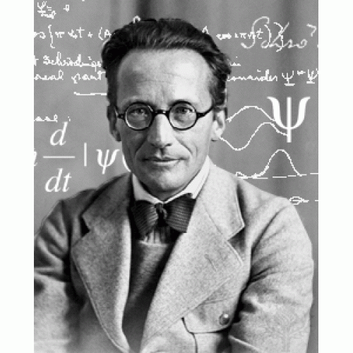
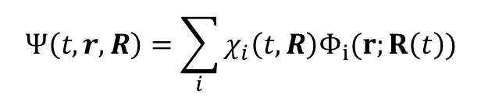
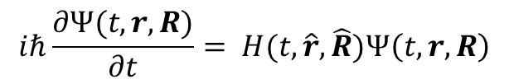
Adiabatic Approximation. Adiabatic and Nonadiabatic Dynamics
$$iℏ\frac{∂Ψ(t,r,R)}{∂t}= H(t,\hat{r},\hat{R})Ψ\left(t, r,R\right)$$
$$Ψ\left(t,r,R\right)=\sum_{i}{χ_{i}\left(t,R\right)Φ_{i}(r;R\left(t\right))}$$
Except for in the exact factorization ansatz!
Adiabatic approximation: keep only one term
1 term is sufficient
Need more than 1 state
Adiabatic Dynamics
Non-Adiabatic Dynamics
Where is the BO approximation?
Energy
Reaction coordinate

Slide 8
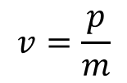
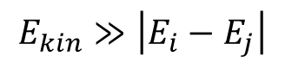
When NA dynamics is needed: Failure of the Born-Oppenheimer Approximation
light atoms (e.g. H – quantum nuclear effects)
high-energy (momentum) – e.g. colliding particles
degeneracies of quantum states (bond-breaking, plasmas, metals)
$$E_{kin}≫\left|E_{i}−E_{j}\right|$$
$$v=\frac{p}{m}$$
BO approximation is fine,
adiabatic regime
BO approximation is fine,
adiabatic regime
BO approximation breaks down here, non-adiabatic regime

Slide 9
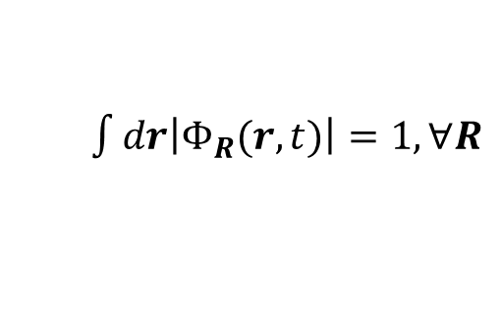
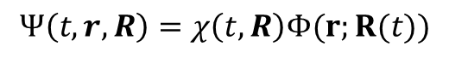
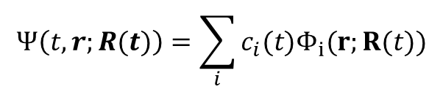
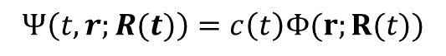
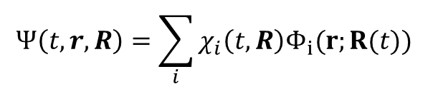
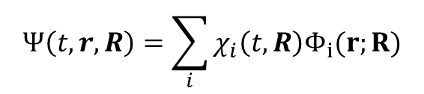
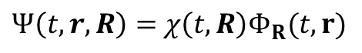
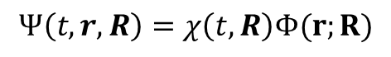
Tiers of approximations to the wavefunction
The solution largely depends on the approximation we make to represent the total wavefunction $Ψ(t,r,R)$
Nonadiabatic
Adiabatic
Exact factorization
$Ψ\left(t,r,R\right)=$ $χ\left(t,R\right)Φ_{R}(t,r)$
Agostini, F.; Curchod, B. F. E. WIREs Computational Molecular Science 2019, 9, e1417. https://doi.org/10.1002/wcms.1417.
$\int{dr\left|Φ_{R}(r,t)\right|=1,}∀R$
Quantum nuclei, with BO approximation (AIMS, QTAG, etc.)
$$Ψ\left(t,r,R\right)=\sum_{i}{χ_{i}\left(t,R\right)Φ_{i}(r;R)}$$
$$Ψ\left(t,r,R\right)=χ\left(t,R\right)Φ(r;R)$$
Makhov, D. V.; Glover, W. J.; Martinez, T. J.; Shalashilin, D. V. J. Chem. Phys. 2014, 141, 054110. https://doi.org/10.1063/1.4891530.
Wavepacket-dressed trajectories
$$Ψ\left(t,r,R\right)=\sum_{i}{χ_{i}\left(t,R\right)Φ_{i}(r;R(t))}$$
Dutra, M.; Garashchuk, S.; Akimov, A. V. Int. J. Quantum Chem. 2023 e27078. https://doi.org/10.1002/qua.27078.
$$Ψ\left(t,r,R\right)=χ\left(t,R\right)Φ(r;R(t))$$
Bare trajectories
Tully, J. C. J. Chem. Phys. 1990, 93, 1061–1071. https://doi.org/10.1063/1.459170.
$$Ψ\left(t,r;R(t)\right)=\sum_{i}{c_{i}(t)Φ_{i}(r;R(t))}$$
$$Ψ\left(t,r;R(t)\right)=c\left(t\right)Φ(r;R(t))$$

Slide 10
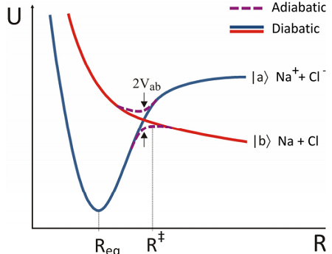
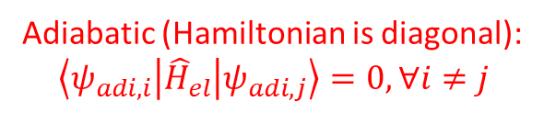
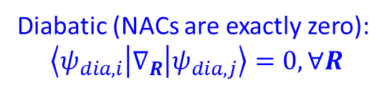
Terminology: Adiabatic and Diabatic States
Adiabatic
(Quasi-)Diabatic
unique
eigenstates of molecular Hamiltonian:
not always chemically-intuitive
non-unique, infinite # of possibilities
Is not an eigenstate of molecular Hamiltonian
usually chosen to be chemically-intuitive
Adiabatic (Hamiltonian is diagonal):
$$\left\langle ψ_{adi, i} | {\hat{H}}_{el} | ψ_{adi,j}\right\rangle =0, ∀i≠j$$
Diabatic (NACs are exactly zero):
$$\left\langle ψ_{dia,i} | ∇_{R} | ψ_{dia,j}\right\rangle =0, ∀R$$
https://chem.libretexts.org/Bookshelves/Physical_and_Theoretical_Chemistry_Textbook_Maps/Book%3A_Time_Dependent_Quantum_Mechanics_and_Spectroscopy_(Tokmakoff)/06%3A_Adiabatic_Approximation/6.03%3A_Diabatic_and_Adiabatic_States

Slide 11
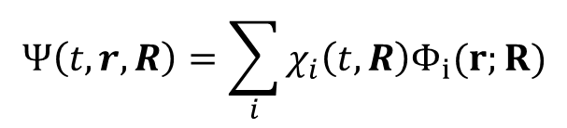
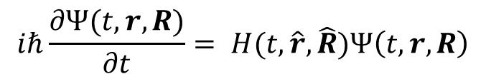
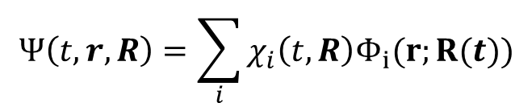
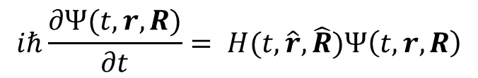
Examples of Deriving Equations of Motion with Different Approximations
Example 1: BO with quantum nuclei
Example 2: BO with wavepacket-dressed trajectories
$$iℏ\frac{∂Ψ(t,r,R)}{∂t}= H(t,\hat{r},\hat{R})Ψ\left(t, r,R\right)$$
$$iℏ\frac{∂Ψ(t,r,R)}{∂t}= H(t,\hat{r},\hat{R})Ψ\left(t, r,R\right)$$
$$Ψ\left(t,r,R\right)=\sum_{i}{χ_{i}\left(t,R\right)Φ_{i}(r;R)}$$
$$Ψ\left(t,r,R\right)=\sum_{i}{χ_{i}\left(t,R\right)Φ_{i}(r;R(t))}$$

Slide 12
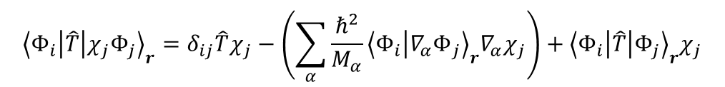
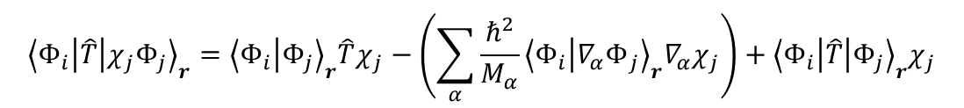

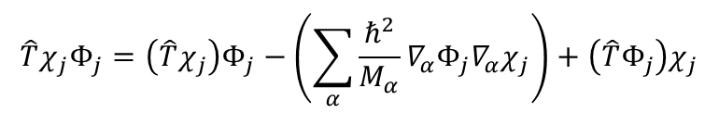

Case 1: Compute the action of $\hat{T}$ on $Ψ$
$$∇^{2}\left(AB\right)=∇\left(∇\left(AB\right)\right)=∇\left(\left(∇A\right)B+A∇B\right)=\left(∇^{2}A\right)B+2\left(∇A\right)\left(∇B\right)+A∇^{2}B$$
$$\left(\sum_{α}{−\frac{ℏ^{2}}{2M_{α}}∇_{α}^{2}}\right)χ_{j}Φ_{j}=\left(\sum_{α}{−\frac{ℏ^{2}}{2M_{α}}∇_{α}^{2}χ_{j}}\right)Φ_{j}−\left(2\sum_{α}{\frac{ℏ^{2}}{{2M}_{α}}∇_{α}Φ_{j}∇_{α}χ_{j}}\right)+\left(\sum_{α}{−\frac{ℏ^{2}}{2M_{α}}∇_{α}^{2}Φ_{j}}\right)χ_{j}$$
$$\hat{T}χ_{j}Φ_{j}=\left(\hat{T}χ_{j}\right)Φ_{j}−\left(\sum_{α}{\frac{ℏ^{2}}{M_{α}}∇_{α}Φ_{j}∇_{α}χ_{j}}\right)+\left(\hat{T}Φ_{j}\right)χ_{j}$$
We keep all terms, because $Φ$ is a function of $R$
Project on an arbitrary state $Φ_{i}$:
$${\left\langle Φ_{i} | \hat{T} | χ_{j}Φ_{j}\right\rangle }_{r}={\left\langle Φ_{i} | Φ_{j}\right\rangle }_{r}\hat{T}χ_{j}−\left(\sum_{α}{\frac{ℏ^{2}}{M_{α}}{\left\langle Φ_{i} | {∇_{α}Φ}_{j}\right\rangle }_{r}∇_{α}χ_{j}}\right)+{\left\langle Φ_{i} | \hat{T} | Φ_{j}\right\rangle }_{r}χ_{j}$$
$${\left\langle Φ_{i} | \hat{T} | χ_{j}Φ_{j}\right\rangle }_{r}=δ_{ij}\hat{T}χ_{j}−\left(\sum_{α}{\frac{ℏ^{2}}{M_{α}}{\left\langle Φ_{i} | {∇_{α}Φ}_{j}\right\rangle }_{r}∇_{α}χ_{j}}\right)+{\left\langle Φ_{i} | \hat{T} | Φ_{j}\right\rangle }_{r}χ_{j}$$
$${\left\langle Φ_{i} | {\hat{H}}_{nucl} | χ_{j}Φ_{j}\right\rangle }_{r}={\left\langle Φ_{i} | {\hat{H}}_{nucl} | Φ_{j}\right\rangle }_{r}χ_{j}={\left\langle Φ_{i} | E_{j}\left(R\right) | Φ_{j}\right\rangle }_{r}χ_{j}=E_{j}\left(R\right){\left\langle Φ_{i} | Φ_{j}\right\rangle }_{r}χ_{j}=E_{j}\left(R\right)δ_{ij}χ_{j}$$
$$\left\langle Φ_{i} | \hat{T}+{\hat{H}}_{nucl} | Ψ\right\rangle =\sum_{j}{{\left\langle Φ_{i} | \hat{T}+{\hat{H}}_{nucl} | χ_{j}Φ_{j}\right\rangle }_{r}}=\sum_{j}{\left[δ_{ij}\hat{T}χ_{j}−\left(\sum_{α}{\frac{ℏ^{2}}{M_{α}}{\left\langle Φ_{i} | {∇_{α}Φ}_{j}\right\rangle }_{r}∇_{α}χ_{j}}\right)+{\left\langle Φ_{i} | \hat{T} | Φ_{j}\right\rangle }_{r}χ_{j}+E_{j}\left(R\right)δ_{ij}\right]}$$

Slide 13
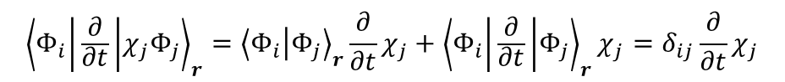
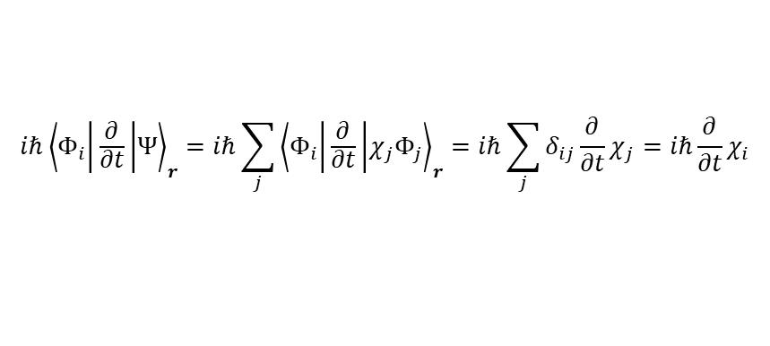
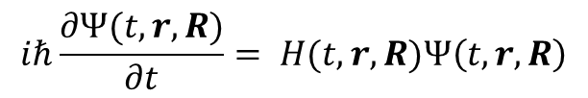
Compute the LHS: Case 1
$${\left\langle Φ_{i} | \frac{∂}{∂t} | χ_{j}Φ_{j}\right\rangle }_{r}={\left\langle Φ_{i} | Φ_{j}\right\rangle }_{r}\frac{∂}{∂t}χ_{j}+{\left\langle Φ_{i} | \frac{∂}{∂t} | Φ_{j}\right\rangle }_{r}χ_{j}=δ_{ij}\frac{∂}{∂t}χ_{j}$$
$$iℏ{\left\langle Φ_{i} | \frac{∂}{∂t} | Ψ\right\rangle }_{r}=iℏ\sum_{j}{{\left\langle Φ_{i} | \frac{∂}{∂t} | χ_{j}Φ_{j}\right\rangle }_{r}}=iℏ\sum_{j}{δ_{ij}\frac{∂}{∂t}χ_{j}}=iℏ\frac{∂}{∂t}χ_{i}$$
Now, combine the two parts of the equation:
$$iℏ\frac{∂Ψ(t,r,R)}{∂t}= H(t,r,R)Ψ\left(t, r,R\right)$$
$$iℏ\frac{∂}{∂t}χ_{i}=\left[\hat{T}+E_{i}\left(R\right)+\left\langle Φ_{i} | \hat{T} | Φ_{i}\right\rangle \right]χ_{i}−\sum_{j,α}{\frac{ℏ^{2}}{M_{α}}\left\langle Φ_{i} | {∇_{α}Φ}_{j}\right\rangle ∇_{α}χ_{j}}−\sum_{j≠i,α}{\frac{ℏ^{2}}{2M_{α}}\left\langle Φ_{i} | {∇_{α}^{2}Φ}_{j}\right\rangle χ_{j}}$$
$$iℏ\frac{∂}{∂t}χ_{i}=\left[\hat{T}+E_{i}\left(R\right)+\left\langle Φ_{i} | \hat{T} | Φ_{i}\right\rangle \right]χ_{i}−iℏ\sum_{j,α}{\left\langle Φ_{i} | {∇_{α}Φ}_{j}\right\rangle \frac{\left(−iℏ∇_{α}\right)χ_{j}}{M_{α}}}−\sum_{j≠i,α}{\frac{ℏ^{2}}{2M_{α}}\left\langle Φ_{i} | {∇_{α}^{2}Φ}_{j}\right\rangle χ_{j}}$$
$$iℏ\frac{∂}{∂t}χ_{i}=\left[\hat{T}+E_{i}\left(R\right)+\left\langle Φ_{i} | \hat{T} | Φ_{i}\right\rangle \right]χ_{i}−iℏ\sum_{j,α}{\left\langle Φ_{i} | {∇_{α}Φ}_{j}\right\rangle \frac{{\hat{p}}_{α}χ_{j}}{M_{α}}}−\sum_{j≠i,α}{\frac{ℏ^{2}}{2M_{α}}\left\langle Φ_{i} | {∇_{α}^{2}Φ}_{j}\right\rangle χ_{j}}$$

Slide 14

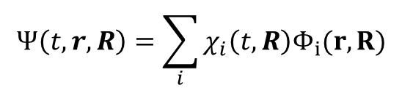
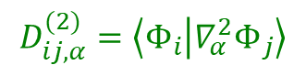
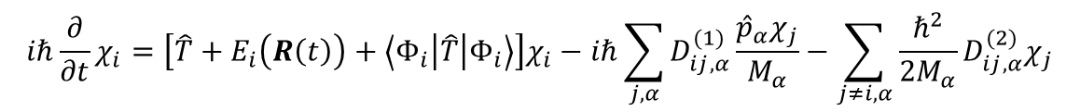
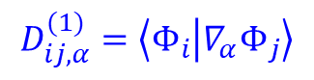
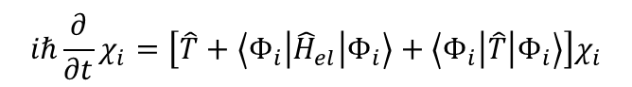
Nonadiabatic dynamics
This is what defines the evolution of nuclear component of the wavefunction and populations of all electronic states.
$$Ψ\left(t,r,R\right)=\sum_{i}{χ_{i}\left(t,R\right)Φ_{i}(r,R)}$$
Diagonal BO correction to the PES!
(ZPE of electrons)
In the adiabatic basis
$$iℏ\frac{∂}{∂t}χ_{i}=\left[\hat{T}+E_{i}\left(R\left(t\right)\right)+\left\langle Φ_{i} | \hat{T} | Φ_{i}\right\rangle \right]χ_{i}−iℏ\sum_{j,α}{D_{ij,α}^{(1)}\frac{{\hat{p}}_{α}χ_{j}}{M_{α}}}−\sum_{j≠i,α}{\frac{ℏ^{2}}{2M_{α}}D_{ij,α}^{(2)}χ_{j}}$$
$$D_{ij,α}^{(1)}=\left\langle Φ_{i} | {∇_{α}Φ}_{j}\right\rangle$$
first-order nonadiabatic couplings (NAC) - vector
Describes how a nuclear DOF $α$ couples electronic state $i$ and $j$
This is what determines the rates of nonadiabatic transitions.
$$D_{ij,α}^{(2)}=\left\langle Φ_{i} | {∇_{α}^{2}Φ}_{j}\right\rangle$$
second-order NAC - scalar
$$iℏ\frac{∂}{∂t}χ_{i}=\left[\hat{T}+\left\langle Φ_{i} | {\hat{H}}_{el} | Φ_{i}\right\rangle +\left\langle Φ_{i} | \hat{T} | Φ_{i}\right\rangle \right]χ_{i}$$
In the diabatic basis
Nuclear dynamics on state i is defined by the probability density: $P_{i}\left(t,R\right)={\left|{\left\langle Φ_{i} | Ψ\right\rangle }_{r}\right|}^{2}={\left|χ_{i}(t,R)\right|}^{2}$
Population of a state $i$: $P_{i}\left(t\right)={\left|{\left\langle Φ_{i} | Ψ\right\rangle }_{r,R}\right|}^{2}={\left|χ_{i}(t)\right|}^{2}$

Slide 15
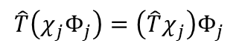
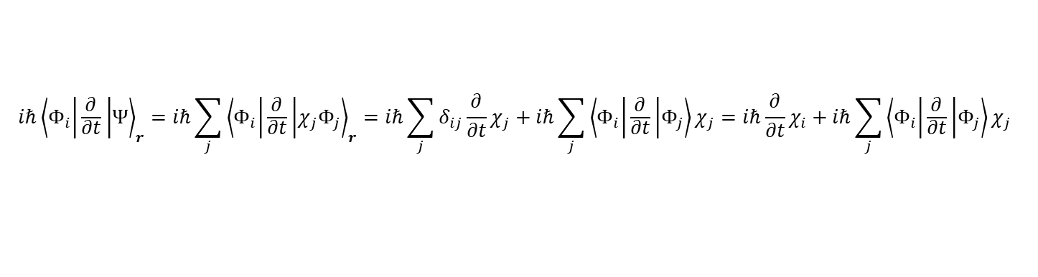
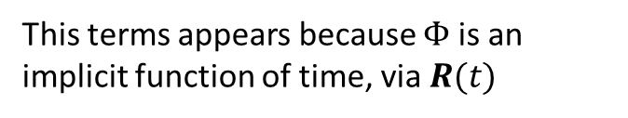
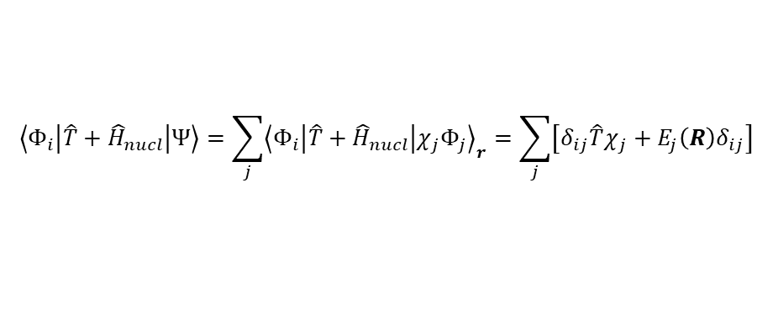
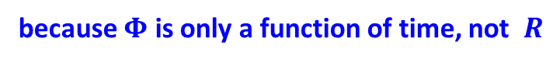
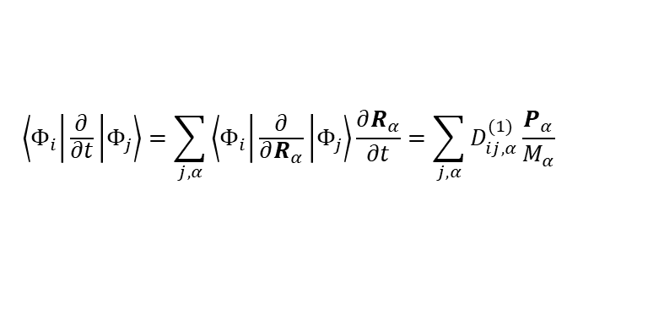
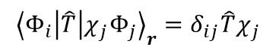

Case 2: Compute the action of $\hat{T}$ on $Ψ$
$$\left(\sum_{α}{−\frac{ℏ^{2}}{2M_{α}}∇_{α}^{2}}\right)χ_{j}Φ_{j}=\left(\sum_{α}{−\frac{ℏ^{2}}{2M_{α}}∇_{α}^{2}χ_{j}}\right)Φ_{j}−\left(2\sum_{α}{\frac{ℏ^{2}}{{2M}_{α}}∇_{α}Φ_{j}∇_{α}χ_{j}}\right)+\left(\sum_{α}{−\frac{ℏ^{2}}{2M_{α}}∇_{α}^{2}Φ_{j}}\right)χ_{j}$$
$$\hat{T}\left(χ_{j}Φ_{j}\right)=\left(\hat{T}χ_{j}\right)Φ_{j}$$
because $Φ$ is only a function of time, not $R$
$${\left\langle Φ_{i} | \hat{T} | χ_{j}Φ_{j}\right\rangle }_{r}=δ_{ij}\hat{T}χ_{j}$$
$$\left\langle Φ_{i} | \hat{T}+{\hat{H}}_{nucl} | Ψ\right\rangle =\sum_{j}{{\left\langle Φ_{i} | \hat{T}+{\hat{H}}_{nucl} | χ_{j}Φ_{j}\right\rangle }_{r}}=\sum_{j}{\left[δ_{ij}\hat{T}χ_{j}+E_{j}\left(R\right)δ_{ij}\right]}$$
$$\left\langle Φ_{i} | \frac{∂}{∂t} | χ_{j}Φ_{j}\right\rangle ={\left\langle Φ_{i} | Φ_{j}\right\rangle }_{r}\frac{∂}{∂t}χ_{j}+\left\langle Φ_{i} | \frac{∂}{∂t} | Φ_{j}\right\rangle χ_{j}=δ_{ij}\frac{∂}{∂t}χ_{j}+\left\langle Φ_{i} | \frac{∂}{∂t} | Φ_{j}\right\rangle χ_{j}$$
Compute the LHS
$$iℏ{\left\langle Φ_{i} | \frac{∂}{∂t} | Ψ\right\rangle }_{r}=iℏ\sum_{j}{{\left\langle Φ_{i} | \frac{∂}{∂t} | χ_{j}Φ_{j}\right\rangle }_{r}}=iℏ\sum_{j}{δ_{ij}\frac{∂}{∂t}χ_{j}}+iℏ\sum_{j}{\left\langle Φ_{i} | \frac{∂}{∂t} | Φ_{j}\right\rangle χ_{j}}=iℏ\frac{∂}{∂t}χ_{i}+iℏ\sum_{j}{\left\langle Φ_{i} | \frac{∂}{∂t} | Φ_{j}\right\rangle χ_{j}}$$
$$iℏ\frac{∂}{∂t}χ_{i}=\left[\hat{T}+E_{i}\left(R\left(t\right)\right)\right]χ_{i}−iℏ\sum_{j}{\left\langle Φ_{i} | \frac{∂}{∂t} | Φ_{j}\right\rangle χ_{j}}$$
$$\left\langle Φ_{i} | \frac{∂}{∂t} | Φ_{j}\right\rangle =\sum_{j,α}{\left\langle Φ_{i} | \frac{∂}{∂R_{α}} | Φ_{j}\right\rangle \frac{∂R_{α}}{∂t}}=\sum_{j,α}{D_{ij,α}^{(1)}\frac{P_{α}}{M_{α}}}$$
This terms appears because $Φ$ is an implicit function of time, via $R(t)$

Slide 16










Summary
Example 1: BO with quantum nuclei
Example 2: BO with wavepacket-dressed trajectories
$$Ψ\left(t,r,R\right)=\sum_{i}{χ_{i}\left(t,R\right)Φ_{i}(r;R)}$$
$$Ψ\left(t,r,R\right)=\sum_{i}{χ_{i}\left(t,R\right)Φ_{i}(r;R(t))}$$
Nonadiabatic, adiabatic basis
$$iℏ\frac{∂}{∂t}χ_{i}=\left[\hat{T}+E_{i}\left(R\left(t\right)\right)+\left\langle Φ_{i} | \hat{T} | Φ_{i}\right\rangle \right]χ_{i}−iℏ\sum_{j,α}{D_{ij,α}^{(1)}\frac{{\hat{p}}_{α}χ_{j}}{M_{α}}}−\sum_{j≠i,α}{\frac{ℏ^{2}}{2M_{α}}D_{ij,α}^{(2)}χ_{j}}$$
$$iℏ\frac{∂}{∂t}χ_{i}=\left[\hat{T}+E_{i}\left(R\left(t\right)\right)\right]χ_{i}−iℏ\sum_{j,α}{D_{ij,α}^{(1)}\frac{P_{α}}{M_{α}}χ_{j}}$$
Nonadiabatic, diabatic basis
$$iℏ\frac{∂}{∂t}χ_{i}=\left[\hat{T}+\left\langle Φ_{i} | {\hat{H}}_{el} | Φ_{i}\right\rangle +\left\langle Φ_{i} | \hat{T} | Φ_{i}\right\rangle \right]χ_{i}$$
$$iℏ\frac{∂}{∂t}χ_{i}=\left[\hat{T}+\left\langle Φ_{i} | {\hat{H}}_{el} | Φ_{i}\right\rangle \right]χ_{i}$$
Adiabatic, adiabatic basis
$$iℏ\frac{∂}{∂t}χ=\left[\hat{T}+E_{i}\left(R\left(t\right)\right)+\left\langle Φ_{i} | \hat{T} | Φ_{i}\right\rangle \right]χ$$
$$iℏ\frac{∂}{∂t}χ=\left[\hat{T}+E_{i}\left(R\left(t\right)\right)\right]χ$$
Adiabatic, diabatic basis
$$iℏ\frac{∂}{∂t}χ=\left[\hat{T}+\left\langle Φ_{i} | {\hat{H}}_{el} | Φ_{i}\right\rangle +\left\langle Φ_{i} | \hat{T} | Φ_{i}\right\rangle \right]χ$$
$$iℏ\frac{∂}{∂t}χ=\left[\hat{T}+\left\langle Φ_{i} | {\hat{H}}_{el} | Φ_{i}\right\rangle \right]χ$$

Slide 17










Wavefunction and selection of representation
$\left.|Ψ\right\rangle$ Abstract wavefunction
$\left\{\left.\left|r\right.\right\rangle :\hat{r}\left.\left|r\right.\right\rangle =r\left.\left|r\right.\right\rangle \right\}$ Position states (Hilbert space)
$\left\{\left.\left|k\right.\right\rangle :\hat{k}\left.\left|k\right.\right\rangle =k\left.\left|k\right.\right\rangle \right\}$ Momentum states (Hilbert space)
$Ψ\left(r\right)=\left\langle r | Ψ\right\rangle$ Wavefunction in a position representation – representation in the basis of position states
$1=\int{dr′\left.|r′\right\rangle \left\langle r^{′}|\right.}$ Complete basis
Indeed
$\left.|Ψ\right\rangle =\int{dr′\left.|r′\right\rangle }\left\langle r′|\left.Ψ\right\rangle \right.=\int{dr′}\left.|r′\right\rangle Ψ\left(r′\right)$
$Ψ\left(r′\right)$ is essentially an expansion coefficient in the basis of coordinate states $\left\{\left.|r\right\rangle \right\}$
Can be regarded as DVR (grid representation of the wavefunction)
$Ψ\left(k\right)=\left\langle k | Ψ\right\rangle$ Likewise, the momentum representation of a wavefunction
$Ψ\left(r\right)=\left\langle r | Ψ\right\rangle ;\left.|r\right\rangle ,\left.|Ψ\right\rangle ∈ℋ_{r}$ only electrons
$Ψ\left(R\right)=\left\langle R | Ψ\right\rangle ;\left.|R\right\rangle ,\left.|Ψ\right\rangle ∈ℋ_{R}$ only nuclei
Different Hilbert spaces:
$Ψ\left(r,R\right)=\left\langle r,R | Ψ\right\rangle$; $\left.|Ψ\right\rangle ∈ℋ_{r}⊗ℋ_{R}$both electrons and nuclei
$Ψ\left(r\right)=\left\langle R | Ψ\right\rangle$; $\left.|Ψ\right\rangle ∈ℋ_{r}⊗ℋ_{R}$ projection on $\left.|R\right\rangle ∈ℋ_{R}$; $Ψ\left(r;R\right)∈ℋ_{r}$ operator of electronic DOF (electronic coordinate operator), but a function of nuclear DOF - $R$

Slide 18










Shorthand notation. Adiabatic and Diabatic Representations
$ψ_{i}\left(r\right)=\left\langle r | i\right\rangle =\left\langle r | ψ_{i}\right\rangle$ electronic coordinates, i-th basis state
Shorthand notation for the entire basis:
$$\left.\left|ψ\right.\right\rangle =\left(\left.\left|ψ_{1}\right.\right\rangle ,\left.\left|ψ_{2}\right.\right\rangle ,…, \left.\left|ψ_{N}\right.\right\rangle \right)$$
Matrix elements
(scalars)
Matrix
$$A_{ij}=\left\langle ψ_{i} | \hat{A} | ψ_{j}\right\rangle ↔A=\left\langle ψ | \hat{A} | ψ\right\rangle$$
Basis:
Adiabatic (Hamiltonian is diagonal):
$$\left\langle ψ_{adi, i} | {\hat{H}}_{el} | ψ_{adi,j}\right\rangle =0, ∀i≠j$$
Diabatic (NACs are exactly zero):
$$\left\langle ψ_{dia,i} | ∇_{R} | ψ_{dia,j}\right\rangle =0, ∀R$$
$$\left.\left|ψ_{adi}\right.\right\rangle =\left.\left|ψ_{dia}\right.\right\rangle U$$
$$H_{adi}=\left\langle ψ_{adi} | {\hat{H}}_{el} | ψ_{adi}\right\rangle$$
Hamiltonians
$$H_{dia}=\left\langle ψ_{dia} | {\hat{H}}_{el} | ψ_{dia}\right\rangle$$
Transformation between bases
$$H_{dia}U=SUH_{adi}$$
$$H_{adi}=U^{+}H_{dia}U={\tilde{H}}_{dia}$$
Wavefunction should be invariant
w.r.t. the basis representation
$$\left.\left|Ψ\left(t\right)\right.\right\rangle =\left.\left|ψ_{adi}\left(t\right)\right.\right\rangle C_{adi}\left(t\right)=\left.\left|ψ_{dia}\left(t\right)\right.\right\rangle C_{dia}\left(t\right)$$

Slide 19






TD-SE in the Shorthand notation
Wavefunction should be invariant
w.r.t. the basis representation
$$\left.\left|Ψ\left(t\right)\right.\right\rangle =\left.\left|ψ_{adi}\left(t\right)\right.\right\rangle C_{adi}\left(t\right)=\left.\left|ψ_{dia}\left(t\right)\right.\right\rangle C_{dia}\left(t\right)$$
$$iℏ\frac{∂}{∂t}\left.\left|Ψ\left(t\right)\right.\right\rangle =\hat{H}\left.\left|Ψ\left(t\right)\right.\right\rangle$$
$$\left.\left|ψ\right.\right\rangle =\left(\left.\left|ψ_{1}\right.\right\rangle ,\left.\left|ψ_{2}\right.\right\rangle ,…, \left.\left|ψ_{N}\right.\right\rangle \right)$$
$$C={\left(c_{1},c_{2},…,c_{N}\right)}^{T}$$
$$\left.\left|ψ_{adi}\left(t\right)\right.\right\rangle C_{adi}\left(t\right)=\left.\left|ψ_{dia}\left(t\right)\right.\right\rangle C_{dia}\left(t\right)$$
$$iℏ\frac{∂}{∂t}\left.\left|ψ_{rep}\left(t\right)\right.\right\rangle C_{rep}+iℏ\left.\left|ψ_{rep}\left(t\right)\right.\right\rangle \frac{∂}{∂t}C_{rep}=\hat{H}\left.\left|ψ_{rep}\left(t\right)\right.\right\rangle C_{rep}$$
$$iℏ\left\langle ψ_{rep}(t)|\right.\frac{∂}{∂t}\left.\left|ψ_{rep}\left(t\right)\right.\right\rangle C_{rep}+iℏ\left\langle ψ_{rep}(t)\right.\left.\left|ψ_{rep}\left(t\right)\right.\right\rangle \frac{∂}{∂t}C_{rep}=\left\langle ψ_{rep}(t)|\right.\hat{H}\left.\left|ψ_{rep}\left(t\right)\right.\right\rangle C_{rep}$$
Projecting:
$$iℏS_{rep}\frac{∂}{∂t}C_{rep}=\left[\left\langle ψ_{rep}(t)|\right.\hat{H}\left.\left|ψ_{rep}\left(t\right)\right.\right\rangle −iℏ\left\langle ψ_{rep}(t)|\right.\frac{∂}{∂t}\left.\left|ψ_{rep}\left(t\right)\right.\right\rangle \right]C_{rep}$$

Slide 20
Transformations. Ehrenfest Dynamics.
Some Implementation Detail In Libra

Slide 21

Libra as a workhorse of our developments
Implemented in Libra: https://quantum-dynamics-hub.github.io/libra/index.html
https://github.com/Quantum-Dynamics-Hub/libra-code
Akimov JCC, 2016, 37, 1626
Examples& Tutorials: https://github.com/compchem-cybertraining
Some of the implemented methods:
Methods | Paper
Surface hopping schemes | Tully, J. C. J. Chem. Phys. 1990, 93, 1061 (FSSH); Wang, L., et al. JCTC 2014, 10, 3598 (GFSH); Akimov, A. V. et al. J. Phys. Soc. Jpn. 2015, 84, 094002 (MSSH)
Decoherence schemes | Granucci, G.; Persico, M. J. Chem. Phys. 2007, 126, 134114 (SDM); Nelson, T. et al. J. Chem. Phys. 2013, 138, 224111. (ID-A, ID-S); Jaeger, H. M. et al. J. Chem. Phys. 2012, 137, 22A545 (DISH)
Dephasing times calculations | Smith, B.; Akimov, A. V. J. Chem.Phys. 2019, 151, 124107 Akimov, A. V.; Prezhdo, O. V. J. Phys. Chem. Lett. 2013, 4, 3857 Sifain, A. E.; Wang, L.; Tretiak, S.; Prezhdo, O. V. Granucci, G.; Persico, M. J. Chem. Phys. 2007, 126, 134114.
Neglect of back-reaction (NBRA) | Prezhdo, O. V.; Duncan, W. R.; Prezhdo, V. V. Prog. Surf. Sci. 2009, 84, 30
Boltzmann-corrected Ehrenfest | Bastida, A. et al. Chem. Phys. Lett. 2006, 417, 53 Smith, B.; Akimov, A. V. J. Chem.Phys. 2019, 151, 124107
Phase corrections | Akimov, A. V J. Phys. Chem. Lett. 2018, 9, 6096
State tracking | Fernandez-Alberti, S.; et al. J. Chem. Phys. 2012, 137, 014512 (mincost); Temen, S.; AVA. JPCL 2021, 12, 10587-10597 (stochastic)
Interfaces with ES codes | DFTB+ (Smith, B.; AVA JPCL. 2020, 11, 1456), QE (Pradhan et al. JPCM, 2018, 30, 484002), CP2K (Smith, B. A. et al. JCTC, 2021, 17, 678), Gaussian, GAMESS (Sato et al. PCCP, 2018, 20, 25275)
Exact dynamics | Kosloff, D. and Kosloff, R. J. Chem. Phys. 1983, 52, 35-53 (SOFT); Colbert, D. T. and Miller, W. H. 1992, 96, 1982-1991 (Colert-Miller DVR)
HEOM | Temen et al. Int. J. Quant. Chem., 2020, 120, e26373

Slide 22




Implementation in Libra classes
Wavefunction language
$$\left.\left|Ψ\left(t\right)\right.\right\rangle =\left.\left|ψ_{adi}\left(t\right)\right.\right\rangle C_{adi}\left(t\right)=\left.\left|ψ_{dia}\left(t\right)\right.\right\rangle C_{dia}\left(t\right)$$
dyn_variables
ndia, nadi, ndof, ntraj
ampl_dia, ampl_adi
dm_adi, dm_dia
Density matrix language
$$\hat{ρ}=\left.\left|Ψ\right.\right\rangle \left\langle \left.Ψ\right|\right.$$
$$P_{adi}=\left\langle ψ_{adi} | \hat{ρ} | ψ_{adi}\right\rangle =\left\langle ψ_{adi} | ψ_{adi}\right\rangle C_{adi}C_{adi}^{+}\left\langle ψ_{adi} | ψ_{adi}\right\rangle =IC_{adi}C_{adi}^{+}I=C_{adi}C_{adi}^{+}$$
$$P_{dia}=\left\langle ψ_{dia} | \hat{ρ} | ψ_{dia}\right\rangle =\left\langle ψ_{dia} | ψ_{dia}\right\rangle C_{dia}C_{dia}^{+}\left\langle ψ_{dia} | ψ_{dia}\right\rangle =SC_{dia}C_{dia}^{+}S$$
So the conversions of the density matrices is:
${UP}_{dia}U^{+}=U^{+}SC_{dia}C_{dia}^{+}SU=C_{adi}C_{adi}^{+}=P_{adi}$ ➔ $P_{dia}=U^{−1}P_{adi}{\left(U^{−1}\right)}^{+}=U^{+}SP_{adi}{\left(U^{+}S\right)}^{+}=U^{+}SP_{adi}SU$
Coefficient transformation:
nHamiltonian
ampl_dia2adi
ampl_adi2dia
compute_adiabatic()
compute_diabatic()
$$C_{dia}=UC_{adi}↔C_{adi}=U^{−1}C_{dia}↔C_{adi}=U^{+}SC_{dia}$$
$$H_{dia}U=SUH_{adi}$$
and also computes derivative couplings and adiabatic gradients
computes $H_{dia}$, $D_{dia}$, and $∇H_{dia}$ according to given methods (e.g. Python modules with Hamiltonian models)

Slide 23













Implementation in the nHamiltonian class
$$\left.\left|ψ\right.\right\rangle =\left(\left.\left|ψ_{1}\right.\right\rangle ,\left.\left|ψ_{2}\right.\right\rangle ,…, \left.\left|ψ_{N}\right.\right\rangle \right)$$
$$D_{dia}=\left\langle ψ_{dia} | \frac{∂}{∂t} | ψ_{dia}\right\rangle$$
$$H_{dia}=\left\langle ψ_{dia} | \hat{H} | ψ_{dia}\right\rangle$$
Scalar NACs
Hamiltonian matrix elements
nHamiltonian
CMATRIX* ham_dia, nac_dia, hvib_dia
CMATRIX* ham_adi, nac_adi, hvib_adi
CMATRIX* ovlp_dia, time_overlap_dia
CMATRIX* ovlp_adi, time_overlap_adi
CMATRIX* basis_transform
vector<CMATRIX*> dc1_adi, dc1_dia
vector<CMATRIX*> d1ham_adi, d1ham_dia
compute_adiabatic()
$$D_{adi}=\left\langle ψ_{adi} | \frac{∂}{∂t} | ψ_{adi}\right\rangle$$
“Vibronic” Hamiltonian
$$H_{adi}=\left\langle ψ_{adi} | \hat{H} | ψ_{adi}\right\rangle$$
$$H_{vib, dia}=H_{dia}−iℏD_{dia}$$
Unitary (similarity) transformation
$$H_{vib, adi}=H_{adi}−iℏD_{adi}$$
$$H_{adi}=U^{+}H_{dia}U={\tilde{H}}_{dia}$$
Time-overlaps (transition density matrices)
$$\left\langle ψ_{dia}(t−Δt) | ψ_{dia}(t)\right\rangle =St_{dia}\left(t−Δt,t\right)≈I$$
$$\left.|ψ_{adi}\right\rangle =\left.|ψ_{dia}\right\rangle U$$
$$\left\langle ψ_{adi}(t−Δt) | ψ_{adi}(t)\right\rangle =St_{adi}\left(t−Δt,t\right)$$
First-order derivative coupling vectors
$$D_{adi}≡\left\langle ψ_{adi} | ∇ψ_{adi}\right\rangle$$
$$\left\langle ψ_{dia} | ψ_{dia}\right\rangle =S$$
The diabatic basis is not necessarily orthonormal
$$D_{dia}≡\left\langle ψ_{dia} | ∇ψ_{dia}\right\rangle$$
$$\left\langle ψ_{adi} | ψ_{adi}\right\rangle =I$$
How to compute NACs?
$$U^{+}∇H_{dia}U−\left({\tilde{D}}_{dia}^{+}H_{adi}+H_{adi}{\tilde{D}}_{dia}\right)=∇H_{adi}−\left(D_{adi}^{+}H_{adi}+H_{adi}D_{adi}\right)$$
Then use special structure of the matrix
$$\tilde{∇H_{dia}}−\left({\tilde{D}}_{dia}^{+}{\tilde{H}}_{dia}+{\tilde{H}}_{dia}{\tilde{D}}_{dia}\right)=∇H_{adi}−\left(D_{adi}^{+}H_{adi}+H_{adi}D_{adi}\right)$$

Slide 24





Nonadiabatic Couplings
Properties of the NACs
$${\overline{D}}_{dia}^{+}+{\overline{D}}_{dia}=∇S$$
$${\overline{D}}_{adi}+{\overline{D}}_{adi}^{+}=∇S_{adi}=0→{\left(D_{adi}^{α}\right)}^{+}=−D_{adi}$$
This is a well-known property!
$$D_{adi}^{α}={\tilde{D}}_{dia}^{α}+U^{+}S∇_{α}U$$
$D_{rep,ij}^{α}≡\left\langle ψ_{rep,i} | ∇_{α}ψ_{rep, j}\right\rangle$ is a scalar
$D_{rep,ij}≡\left\langle ψ_{rep,i} | ∇ψ_{rep, j}\right\rangle$ understood as a column-vector
${\overline{D}}_{rep}≡\left\langle ψ_{rep} | ∇ψ_{rep }\right\rangle$ understood as a vector of matrices $D_{rep}^{α}=\left\langle ψ_{rep} | ∇_{α}ψ_{rep }\right\rangle$
Important observations
the equation becomes an identity when $U=I$
$$\tilde{∇_{α}H_{dia}}−\left({\left(D_{adi}^{α}\right)}^{+}{\tilde{H}}_{dia}+{\tilde{H}}_{dia}{\tilde{D}}_{dia}^{α}\right)=∇_{α}H_{adi}−\left({\left(D_{adi}^{α}\right)}^{+}H_{adi}+H_{adi}D_{adi}^{α}\right)$$
$$U^{+}\left\langle ψ_{dia} | ∇_{α}H | ψ_{dia}\right\rangle U$$
$$\left\langle ψ_{adi} | ∇_{α}H | ψ_{adi}\right\rangle$$

Slide 25



Quantum-Classical Hamiltonian and Ehrenfest forces
$$H^{MF}\left(R,P;Ψ\right)=\frac{\left\langle Ψ | H^{qc}\left(R,P\right) | Ψ\right\rangle }{\left\langle Ψ | Ψ\right\rangle }=\frac{1}{2}P^{T}M^{−1}P+\frac{C_{adi}^{+}H_{adi}C_{adi}}{C_{adi}^{+}C_{adi}}=\frac{1}{2}P^{T}M^{−1}P+\frac{C_{dia}^{+}H_{dia}C_{dia}}{C_{dia}^{+}SC_{dia}}$$
nHamiltonian
Ehrenfest_energy_adi
Ehrenfest_energy_dia
TD-SE for the amplitudes
$$iℏS\frac{dC_{rep}}{dt}=\left(H_{rep}−iℏd_{rep}\right)C_{rep}$$
$$\frac{dH^{MF}}{dt}=0$$
Energy conservation
$$\dot{R}=M^{−1}P$$
$$\dot{P}=f^{MF}\left(R,Ψ_{rep}\right)$$
Enforcing the “classical” form of equations of motion for nuclear DOFs
$$f_{n}^{MF}≡f_{n,adi}^{MF}=\frac{1}{C_{adi}^{+}C_{adi}}C_{adi}^{+}F_{adi,n}^{HF}C_{adi}=f_{n,dia}^{MF}=\frac{1}{C_{dia}^{+}SC_{dia}}C_{dia}^{+}F_{dia,n}^{HF}C_{dia}$$
nHamiltonian
Ehrenfest_forces_adi
Ehrenfest_forces_dia
Ehrenfest_forces_tens_adi
Ehrenfest_forces_tens_dia
$$F_{adi,n}^{HF}=−\left\langle ψ_{adi} | ∇_{n}H | ψ_{adi}\right\rangle =\left[−∇_{n}H_{adi}+D_{adi,n}^{+}H_{adi}+H_{adi}D_{adi,n}\right]$$
$$F_{dia,n}^{MF}=−\left\langle ψ_{dia} | ∇_{n}H | ψ_{dia}\right\rangle =\left[−∇_{n}H_{dia}+D_{dia,n}^{+}S^{−1}H_{dia}+H_{dia}S^{−1}D_{dia,n}\right]$$

Slide 26
Integrators and Local Diabatization

Slide 27




Trivial Crossing Problem
We want to solve
$$iℏ\frac{∂}{∂t}\left.\left|Ψ\left(t\right)\right.\right\rangle =\hat{H}\left.\left|Ψ\left(t\right)\right.\right\rangle$$
in the adiabatic basis:
$$\left.\left|Ψ\left(t\right)\right.\right\rangle =\left.\left|ψ_{adi}\left(t\right)\right.\right\rangle C_{adi}\left(t\right)$$
Formal solution:
$$\left.\left|Ψ\left(t+Δt\right)\right.\right\rangle =\left[\int_{0}^{Δt}{dτ}\exp\left(−\frac{iτ}{ℏ}\hat{H}\left(t+τ\right)\right)\right]\left.\left|Ψ\left(t\right)\right.\right\rangle =\left.\left|ψ_{adi}\left(t+Δt\right)\right.\right\rangle C_{adi}\left(t+Δt\right)$$
Consider the change of $C_{adi}$ non-adiabatic dynamics
After projection:
$$C_{adi}\left(t+Δt\right)=\left\langle ψ_{adi}\left.\left(t+Δt\right)\right|\right.\left[\int_{0}^{Δt}{dτ}\exp\left(−\frac{iτ}{ℏ}\hat{H}\left(t+τ\right)\right)\right]\left.\left|ψ_{adi}\left(t\right)\right.\right\rangle C_{adi}\left(t\right)$$
However, the bases $\left.|ψ_{adi}(t)\right\rangle$ and$\left.|ψ_{adi}(t+Δt)\right\rangle$ may change their relative order (e.g. in trivial crossing situations) or acquire a spurious phase difference. Consider this as the adiabatic dynamics (e.g. adiabatic charge transfer)

Slide 28
Trivial Crossing Problem
Arises because of finite $Δt$ or due to inconsistency of energy and NAC (due to approximations)

Slide 29









Local Diabatization (LD) Approach
Introduce the dynamically-consistent (local diabatic) basis, $\left.|{\tilde{ψ}}_{adi}(t)\right\rangle$: $\left\langle {\tilde{ψ}}_{adi}(t) | {\tilde{ψ}}_{adi}(t+Δt)\right\rangle ≈I$
The idea: these basis functions preserve their identity as much as possible
Closely related to the one in the LD of Granucci et al.
Introduce the basis re-projection matrix, $T(t)$: it describes the adiabatic dynamics of the basis
$$\left.\left|{\tilde{ψ}}_{adi}\left(t\right)\right.\right\rangle =\left.\left|ψ_{adi}\left(t\right)\right.\right\rangle T\left(t\right)$$
$$T=T_{LD}^{−1}$$
Granucci G, Persico M, Toniolo A J. Chem. Phys. 2001, 114, 10608
The wavefunction should stay invariant w.r.t. the choice of the basis:
$$\left.\left|Ψ(t)\right.\right\rangle =\left.\left|{\tilde{ψ}}_{adi}\left(t\right)\right.\right\rangle {\tilde{C}}_{adi}\left(t\right)=\left.\left|ψ_{adi}\left(t\right)\right.\right\rangle C_{adi}\left(t\right)$$
$$C_{adi}\left(t\right)=T\left(t\right){\tilde{C}}_{adi}\left(t\right)$$
Use the definitions above:
$$T^{+}\left(t\right)\left\langle ψ\left(t\right) | ψ\left(t+Δt\right)\right\rangle T\left(t+Δt\right)=T^{+}\left(t\right)P\left(t , t+Δt\right)T\left(t+Δt\right)≈I$$
Time-overlap (transition density matrix):
$$P\left(t,t+Δt\right)=\left\langle ψ\left(t\right) | ψ\left(t+Δt\right)\right\rangle$$
Solving for the re-projection matrix:
$$T\left(t+Δt\right)={\left[T^{+}\left(t\right)P\left(t,t+Δt\right)\right]}^{−1}$$
but this leads to fast accumulation of errors
so, should not evolve the re-projection matrix globally, only locally:
$$T\left(t\right)=I$$
$$T(t+Δt)=P^{−1}(t,t+Δt)$$
Local diabatization assumption

Slide 30



Lowdin normalization in the LD approach
However, this transformation will not preserve the wavefunction norm:
$$T\left(t+Δt\right)={\left[P\left(t,t+Δt\right)\right]}^{−1}$$
$$\left.\left|ψ_{adi}\left(t+Δt\right)\right.\right\rangle =\left.\left|{\tilde{ψ}}_{adi}\left(t+Δt\right)\right.\right\rangle T^{−1}\left(t+Δt\right)$$
$Tr\left[\left\langle ψ\left(t+Δt\right) | ψ\left(t+Δt\right)\right\rangle \right]=Tr\left[{\left(T^{−1}\right)}^{+}\left\langle \tilde{ψ}\left(t+Δt\right) | \tilde{ψ}\left(t+Δt\right)\right\rangle T^{−1}\right]=Tr\left[\left\langle \tilde{ψ}\left(t+Δt\right) | \tilde{ψ}\left(t+Δt\right)\right\rangle T^{−1}{\left(T^{−1}\right)}^{+}\right]=Tr\left[\left\langle \tilde{ψ}\left(t+Δt\right) | \tilde{ψ}\left(t+Δt\right)\right\rangle T^{−1}{\left(T^{+}\right)}^{−1}\right]=Tr\left[\left\langle \tilde{ψ}\left(t+Δt\right) | \tilde{ψ}\left(t+Δt\right)\right\rangle {\left(T^{+}T\right)}^{−1}\right]≠ Tr\left[\left\langle \tilde{ψ}\left(t+Δt\right) | \tilde{ψ}\left(t+Δt\right)\right\rangle \right]$.
Normalize the $T$ matrix: $T→\tilde{T}=TA$ such that ${\tilde{T}}^{+}\left(t+Δt\right)\tilde{T}\left(t+Δt\right)=A^{+}T^{+}\left(t+Δt\right)T\left(t+Δt\right)A=I$
The matrix $A$ can be chosen as: $A={\left(T^{+}\left(t+Δt\right)T\left(t+Δt\right)\right)}^{−1/2}$
So the normalized matrix is: $\tilde{T}\left(t+Δt\right)=T\left(t+Δt\right){\left(T^{+}\left(t+Δt\right)T\left(t+Δt\right)\right)}^{−1/2}$
$$T\left(t\right)=I$$
$$T(t+Δt)=P^{−1}(t,t+Δt){\left({\left[P^{−1}(t,t+Δt)\right]}^{+}P^{−1}(t,t+Δt)\right)}^{−1/2}$$
Local diabatization with Lowdin normalizaiton

Slide 31



Back to Integrating the TD-SE
$$U\left(t,t+Δt\right)=\left\langle ψ_{adi}\left.\left(t+Δt\right)\right|\right.\left[\int_{0}^{Δt}{dτ}\exp\left(−\frac{iτ}{ℏ}\hat{H}\left(t+τ\right)\right)\right]\left.\left|ψ_{adi}\left(t\right)\right.\right\rangle$$
$$\left[\int_{0}^{Δt}{dτ}\exp\left(−\frac{iτ}{ℏ}\hat{H}\left(τ\right)\right)\right]≈\left[\exp\left(−\frac{iΔt}{2ℏ}\left[\hat{H}\left(t\right)+\hat{H}\left(t+Δt\right)\right]\right)\right]≈\left[\exp\left(−\frac{iΔt}{2ℏ}\hat{H}\left(t+Δt\right)\right)\right]\left[\exp\left(−\frac{iΔt}{2ℏ}\hat{H}\left(t\right)\right)\right]$$
$$U\left(t,t+Δt\right)≈\left\langle ψ_{adi}\left.\left(t+Δt\right)\right|\right.\left[\exp\left(−\frac{iΔt}{2ℏ}\hat{H}\left(t+Δt\right)\right)\right]\left[\exp\left(−\frac{iΔt}{2ℏ}\hat{H}\left(t\right)\right)\right]\left.\left|ψ_{adi}\left(t\right)\right.\right\rangle$$
Using properties of the local-diabatic basis:
$$\left|\left.{\tilde{ψ}}_{adi}\left(t+Δt\right)\right\rangle \left\langle {\tilde{ψ}}_{adi}\left.\left(t\right)\right|\right.≈\right|\left.{\tilde{ψ}}_{adi}\left(t\right)\right\rangle \left\langle {\tilde{ψ}}_{adi}\left.\left(t+Δt\right)\right|\right.≈\hat{I}$$
$U\left(t,t+Δt\right)≈\left\langle ψ_{adi}\left.\left(t+Δt\right)\right|\right.\left[\exp\left(−\frac{iΔt}{2ℏ}\hat{H}\left(t+Δt\right)\right)\right]\left.{\tilde{ψ}}_{adi}\left(t+Δt\right)\right\rangle \left\langle {\tilde{ψ}}_{adi}\left.\left(t\right)\right|\right.\left[\exp\left(−\frac{iΔt}{2ℏ}\hat{H}\left(t\right)\right)\right]\left.\left|ψ_{adi}\left(t\right)\right.\right\rangle =\left\langle ψ_{adi}\left.\left(t+Δt\right)\right|\right.\left[\exp\left(−\frac{iΔt}{2ℏ}\hat{H}\left(t+Δt\right)\right)\right]\left.ψ_{adi}\left(t+Δt\right)\right\rangle T\left(t+Δt\right)T^{+}\left(t\right)\left\langle ψ_{adi}\left.\left(t\right)\right|\right.\left[\exp\left(−\frac{iΔt}{2ℏ}\hat{H}\left(t\right)\right)\right]\left.\left|ψ_{adi}\left(t\right)\right.\right\rangle =A(t+Δt)T\left(t+Δt\right)$ $A(t)$
$$A\left(t\right)=\left\langle ψ_{adi}\left.\left(t\right)\right|\right.\left[\exp\left(−\frac{iΔt}{2ℏ}\hat{H}\left(t\right)\right)\right]\left.\left|ψ_{adi}\left(t\right)\right.\right\rangle$$

Slide 32









Working the Liouville’s space: propagation of density matrix
$$iℏ\frac{∂\hat{ρ}}{∂t}=\left[\hat{H},\hat{ρ}\right]$$
Vectorized form of the QCLE
$${\tilde{L}}_{ij,ab}={\tilde{H}}_{ia}δ_{bj}−{\tilde{H}}_{bj}δ_{ai}$$
$$\frac{∂{\tilde{ρ}}_{ij}}{∂t}=−\frac{i}{ℏ}\sum_{a,b}{{\tilde{L}}_{ij,ab}{\tilde{ρ}}_{ab}}$$
$$\frac{∂vec\left(\tilde{ρ}\right)}{∂t}=−i\tilde{L}∗vec\left(\tilde{ρ}\right)$$
$$\tilde{H}=\left\langle \tilde{ψ} | \hat{H} | \tilde{ψ}\right\rangle =T^{+}\left\langle ψ | \hat{H} | ψ\right\rangle T$$
$N×N$ matrix
$N^{2}×N^{2}$ matrix
$N^{2}×1$ vector
For the “closed” quantum systems, there is a direct correspondence between wavefunction and density matrix, so:
$$ρ_{adi}=C_{adi}C_{adi}^{+}=T{\tilde{C}}_{adi}{\tilde{C}}_{adi}^{+}T^{+}=T{\tilde{ρ}}_{adi}T^{+}$$
$${\tilde{ρ}}_{adi}=T^{−1}ρ_{adi}{\left(T^{+}\right)}^{−1}=T^{+}ρ_{adi}T$$
$$ρ\left(t+Δt\right)=T\left(t+Δt\right)vec^{−1}\left\{\left[\int_{0}^{Δt}{dτ}\exp\left(−\frac{iτ}{ℏ}\tilde{L}\left(t+τ\right)\right)\right]vec\left(ρ\left(t\right)\right)T\right\}T^{+}\left(t+Δt\right)$$
So, the final expression:

Slide 33
Trajectory Surface Hopping (TSH) methods
in Libra

Slide 34
TSH in the nutshell
Initialization
Nuclear dynamics
$\dot{p_{i}}=−\frac{∂H}{∂r_{i}}$ $\dot{r_{i}}=\frac{∂H}{∂p_{i}}$
Stationary adiabatic states
$${\hat{H}}_{el}ψ_{i}=E_{i}ψ_{i}$$
Non-adiabatic Couplings
$$d_{ij}=\frac{\left\langle ψ_{i}(t) | ψ_{j}(t+dt)\right\rangle −\left\langle ψ_{i}(t+dt) | ψ_{j}(t)\right\rangle }{2dt}$$
Electronic Dynamics
$$Ψ\left(r,R,t\right)=\sum_{i}{c_{i}\left(t\right)ψ_{i}(r;R(t))}$$
$$iℏ\frac{∂c_{i}(t)}{∂t}=\sum_{j}{\left(E_{i}δ_{ij}−iℏd_{ij}\right)}c_{j}$$
NBRA
Decoherence 1
$$c_{i}→c_{i}\exp\left(−\frac{Δt}{τ_{ij}}\right), ∀i≠j$$
as in SDM
Proposed Hops
Decoherence 2
$$P_{i→j}=Δt∗Re\left(\frac{2{\frac{p}{m}d}_{ij}c_{i}^{∗}c_{j}}{c_{i}^{∗}c_{i}}\right)$$
or as in DISH
based on energy conservation or
$$P_{i→f}^{A}=\min\left(1, \exp\left(−\frac{ΔE}{k_{B}T}\right)\right)$$
Accept Hops
Change of state/Velocity rescaling
change active electronic state, rescale velocity

Slide 35



Options for the Dynamics
dyn_control_params
rep_tdse
ham_update_method
ham_transform_method
force_method
rep_force
how to evolve electronic DOFs: 0 - $C_{dia}$; 1 - $C_{adi}$; 2 - $P_{dia}$; 3 - $P_{adi}$
how to update Ham: 0 – don’t; 1 – update $H_{dia}$; 2 – update $H_{adi}$
$$H_{dia}U=SUH_{adi}$$
how to update Ham via transformation :
0 – don’t;
1 – compute $H_{adi}$ from $H_{dia}$ by solving $H_{dia}U=SUH_{adi}$
2 – compute $H_{adi}$ from $H_{dia}$ by using a provided $U:$ $H_{adi}={\left(SU\right)}^{−1}H_{dia}U=U^{+}H_{dia}U$
3 – compute $H_{dia}$ from $H_{adi}$ by using a provided $U:$ $H_{dia}=SUH_{adi}U^{−1}=SUH_{adi}U^{+}S$
how to compute nuclear forces:
0 – don’t
1 – state-specific, adiabatic forces: $−\frac{∂E_{adi}}{∂R}$
2 – Ehrenfest forces
$$f_{n,dia}^{MF}=\frac{1}{C_{dia}^{+}SC_{dia}}C_{dia}^{+}F_{dia,n}^{HF}C_{dia}=f_{n,adi}^{MF}=\frac{1}{C_{adi}^{+}C_{adi}}C_{adi}^{+}F_{adi,n}^{HF}C_{adi}$$
0 – using only diabatic properties; 1 – using adiabatic properties

Slide 36


Options for the Dynamics
dyn_control_params
force_method
enforce_state_following
enforced_state_index
time_overlap_method
how to compute nuclear forces:
0 – don’t
1 – state-specific, adiabatic forces: $−\frac{∂E_{adi}}{∂R}$
2 – Ehrenfest forces
Wheather we want to enforce nuclear dynamics to be on a given state, regardlenss of the TSH transitions: 0 - no [ default ]; 1 - yes
If we enforce the nuclear dynamics to be on a given state, what is the index of that state [any integer >- 0, default = 0 ]
The default value of 0 enforces the nuclear dynamics to be on the ground state.
How to get the time-overlaps $P_{adi}(t−Δt,t)=\left\langle ψ_{adi}(t−Δt) | ψ_{adi}(t)\right\rangle$ in the dynamics.
0 - based on the wavefunctions (the Hamiltonian shall have the basis_transform variables updated) [ default ]$P_{adi}\left(t−Δt,t\right)=U^{+}\left(t−Δt\right)P_{dia}\left(t−Δt,t\right)U(t)$
1 - based on external calculations (the Hamiltonian shall have the time_overlap_adi member updated) - use for NBRA

Slide 37



Options for the Dynamics
dyn_control_params
nac_update_method
nac_algo
hvib_update_method
How to update NACs and vibronic Hamiltonian before electronic TD-SE propagation.
0: don't update them (e.g. for simplest NAC)
1: update according to changed momentum and existing derivative couplings [ default ]
$$d_{ij}=\sum_{n}{D_{ij,n}^{adi}\frac{P_{n}}{M_{n}}}$$
2: update according to time-overlaps (only time-derivative NACs)
How to compute time-derivative NACs (if nac_update_method==2)
(-1): don’t update, e.g. we use NACs from somewhere else [ default ]
0: use HST formula: $d_{ij}\left(t+\frac{Δt}{2}\right)=\frac{St_{ij}\left(t,t+Δt\right])−St_{ij}^{+}\left(t,t+Δt\right])}{2Δt}$
1: use NPI of Meek and Levine
Meek, G. A.; Levine, B. G. J. Phys. Chem. Lett. 2014, 5, 2351. https://doi.org/10.1021/jz5009449.
$$d\left(t+\frac{Δt}{2}\right)≈\frac{1}{Δt}\int_{0}^{dt}{\left\langle ψ\left(t^{′}\right) | \frac{∂}{∂t^{′}} | ψ\left(t^{′}\right)\right\rangle dt^{′}}= \frac{1}{Δt}\int_{0}^{dt}{T^{+}\left(t^{′}\right)\frac{∂}{∂t^{′}}T\left(t^{′}\right)dt^{′}}=\frac{log\left[T\left(t+Δt\right)\right]}{Δt}$$
$$T\left(t+Δt\right)=S′\left(t,t+Δt\right)=\left\langle ψ\left(t\right) | ψ\left(t+Δt\right)\right\rangle$$
How to update $H_{vib,dia}$ and $H_{vib. adi}$
- 0: don't update them (e.g. if it is read externally)
- 1: update according to regular formula: $H_{vib,rep}=H_{rep}−iℏd_{ij,rep}$

Slide 38









Hop Proposal Probability
tsh_method;
- [-1]: adiabatic dynamics, no hops [ default ]
- 0: Fewest Switches Surface Hopping (FSSH)
- 1: Global Flux Surface Hopping (GFSH)
- 2: Markov-State Surface Hopping (MSSH)
- 3: Landau-Zener (LZ) options
- 4: Zhu-Nakamura (ZN) options
- 5: DISH
$$P_{i→f}^{P}=max\left(0,\frac{Δt}{ℏP_{ii}}Im\left[P_{i,f}H_{f,i }^{vib} −H_{i,f }^{vib}P_{f,i}\right]\right)$$
Tully, J. C. J. Chem. Phys. 1990, 93, 1061
$$P_{i→f}^{P}=max\left(0,\frac{ΔP_{ff}}{P_{ff}}\frac{ΔP_{jj}}{\sum_{k∈A}{ΔP_{kk}}} \right). i∈A,j∈B$$
Wang, L.; Trivedi, D.; Prezhdo, O. V. JCTC 2014, 10, 3598
$$P_{i→j}^{P}=\exp\left(−\frac{π}{4\sqrt{a^{2}}} \sqrt{\frac{2}{b^{2}+\sqrt{\left|b^{4}+sign\left(F_{i}^{T}F_{j}\right)\right|}}}\right)$$
$$P_{i→f}^{P}(t,t+Δt)=P_{ff}(t+Δt)$$
Akimov, A. V.; Trivedi, D.; Wang, L.; Prezhdo, O. V. J. Phys. Soc. Jpn. 2015, 84, 094002
$$a^{2}=\frac{ℏ^{2}}{2μ}\frac{\sqrt{\left|F_{i}^{T}F_{j}\right|} \left|F_{i}−F_{j}\right|}{{\left(2H_{ij}^{dia}\right)}^{3}}$$
$$b^{2}=\left(E−E_{i}\left(R=R_{c}\right)\right)\frac{\left|F_{i}−F_{j}\right|}{\sqrt{\left|F_{i}F_{j}\right|} \left(2H_{ij}^{dia}\right)}$$
$$P_{i→j}^{P}=\exp\left(−\frac{2π}{ℏ}γ^{LZ}\right)$$
$$\frac{1}{\sqrt{μ}}\left|F_{i}−F_{j}\right|→\sqrt{{\left(F_{i}−F_{j}\right)}^{T}M^{−1}\left(F_{i}−F_{j}\right)}$$
$$γ^{LZ}=\frac{{\left|H_{ij}^{dia}\right|}^{2}}{v^{T}\left(∇\left|H_{ii}^{dia}−H_{jj}^{dia}\right|\right)}$$
Multidimensional version
$$\frac{1}{\sqrt{μ}}\left|F_{i}F_{j}\right|→\sqrt{\left|{F_{i}}^{T}M^{−1}F_{j}\right|}$$

Slide 39

DISH
Initialize “coherence time” for each state $t_{i}=0, ∀i$
Advance “coherence time”: $t_{i}=t_{i}+Δt, ∀i$
Initialize set of “decohering” states: $D=∅$
For all states $i$:
compute coherence interval for this state $τ_{i}^{−1}=\sum_{j≠i}{ρ_{jj}(t)τ_{ij}^{−1}}$
If $t_{i}≥T[τ_{i}]$, add $i$ to set $D$: $D=D∪\{i\}$
int dish_decoherence_event_option;
0 – direct compare
1 -Poisson
$$D≠∅$$
No (B)
Continue coherent evolution:
$$c\left(t+Δt\right)=\exp\left(−\frac{iH}{ℏ}Δt\right)c\left(t\right)$$
Yes (A)
Select a single decohered state, $i$, our of the set randomly
reset $t_{i}=0$
don’t change the variables for other states
Yes
…
Yes (1)
Is $i$ active state?
No (2)
…
Finish scheme in panel (b)

Slide 40
DISH
Yes (1)
Is $i$ active state?
No (2)
$$ξ<{\left|c_{i}\right|}^{2}$$
$$ξ<{\left|c_{i}\right|}^{2}$$
Yes (1.1)
No (1.2)
Yes (2.1)
No (2.2)
Collapse onto state $i$:
$c_{i}=\text{"1}“$; $c_{j}=0$
Stay on the active state $i$
Exit
$P=\left\{all\right\}/\{i\}$ becomes a set of proposed states
$i$ becomes a proposed state
Project out state $i$:
$c_{i}=0$; $c_{j}→\tilde{c_{j}};j≠i$
Exit
Yes (1.2.1)
$P=∅$?
Do nothing
Exit
Is hop accepted?
No (1.2.2)
No (2.1.2)
Select $j$ randomly with prob.~ ${\left|c_{j}\right|}^{2},$ $j∈P$
Mark $j$ as a proposed hop
Do nothing
Exit
Yes (2.1.1)
Yes (1.2.2.1)
Is hop accepted?
Collapse onto state $i$, $c_{i}=\text{"1}“$, $c_{j}=0;j≠i$
Hop onto $i$
Exit
Project out state $i$, $c_{i}=0$, $c_{k}→\tilde{c_{k}}, k≠i$
Hop onto $j$
Exit
No (1.2.2.2)
Exclude state $j$ from $P$

Slide 41



Hop Acceptance Probabilities
int hop_acceptance_algo;
Options:
- 0: accept all proposed hops [ default ]
- 10: based on adiabatic energy - accept only those hops that can obey the energy conservation with
adiabatic potential energies
- 11: based on diabatic energy - same as 10, but we use diabatic potential energies
- 20: based on derivative coupling vectors - accept only those hops that can obey the energy conservation
by rescaling nuclear velocities along the directions of derivative couplings for the quantum nuclear DOFs
- 21: based on difference of state-specific forces - same as 20, but the rescaling is done along the vector
parallel to the difference of adiabatic forces on initial and target states
- 31: accept hops with the probability taken from the quantum Boltzmann distribution
- 32: accept hops with the probability taken from the classical Maxwell-Boltzmann distribution
- 33: accept hops with the probability taken from the updated quantum Boltzmann distribution (experimental)
$$P_{i→f}^{A}=1$$
$$P_{i→f}^{A}=Θ\left(E_{kin}+E_{f}−E_{f}\right)$$
Tully, J. C. J. Chem. Phys. 1990, 93, 1061
$$P_{i→f}^{A}=\min\left(1, \exp\left(−\frac{ΔE}{k_{B}T}\right)\right)$$
Prezhdo, O. V.; Duncan, W. R.; Prezhdo, V. V. Prog. Surf. Sci. 2009, 84, 30
$$P_{i→f}^{A}=1−\left[\operatorname{erf}\left({\left(\frac{ΔE}{k_{B}T}\right)}^{\frac{1}{2}}\right)−\sqrt{\frac{4}{π}}{\left(\frac{ΔE}{k_{B}T}\right)}^{\frac{1}{2}}\exp\left(−\frac{ΔE}{k_{B}T}\right)\right]$$
Smith, B.; Akimov, A. V. J. Chem.Phys. 2019, 151, 124107

Slide 42
Momentum Rescaling
int momenta_rescaling_algo;
Options:
- 0: don't rescale [ default ]
- 100: based on adiabatic energy, don't reverse on frustrated hops
- 101: based on adiabatic energy, reverse on frustrated hops
- 110: based on diabatic energy, don't reverse on frustrated hops
- 111: based on diabatic energy, reverse on frustrated hops
- 200: along derivative coupling vectors, don't reverse on frustrated hops
- 201: along derivative coupling vectors, reverse on frustrated hops
- 210: along difference of state-specific forces, don't reverse on frustrated hops
- 211: along difference of state-specific forces, reverse on frustrated hops

Slide 43




Decoherence: SMD, ID-A
double decoherence_algo;
Options:
- [-1]: no decoherence [ default ]
- 0: SDM and alike
- 1: instantaneous decoherence options (ID-S, ID-A, ID-C)
- 2: AFSSH
- 3: BCSH of Linjun Wang
- 4: MF-SD of Bedard-Hearn, Larsen, Schwartz
int collapse_option;
How to collapse wavefunction amplitudes in the decoherence schemes:
- 0: by rescaling the magnitude of the amplitude vector elements, but preserving "phase" [ default ]
- 1: by resetting the amplitudes to 1.0+0.0j. This option changes phase
int instantaneous_decoherence_variant;
- 0: ID-S
- 1: ID-A [default]
- 2: ID-C - consistent ID - an experimental algorithm
SDM
ID-A
Nelson, T.; Fernandez-Alberti, S.; Roitberg, A. E.; Tretiak, S. J. Chem. Phys. 2013, 138, 224111.
Granucci, G.; Persico, M. J. Chem. Phys. 2007, 126, 134114.
gradually change the amplitudes
$$C_{i}^{′}=C_{i}\exp\left(−\frac{Δt}{τ_{if}}\right), ∀i≠f$$
on a successful hop (ID-S)
on an attempted hop (ID-A)
at every timestep (ID-C)
$$C_{f}^{′}=C_{f}\sqrt{\frac{1−\sum_{i≠f}{{\left|C_{i}^{′}\right|}^{2}}}{{\left|C_{f}\right|}^{2}}}$$
Wavefunction reduction
$$C_{f}=1, C_{i}=0, ∀i≠f$$

Slide 44

Decoherence: A-FSSH
Propagate extra set of variables
These variables define the rates for wavefunction collapse

Slide 45



Decoherence: BCSH and MF-SD
BCSH
MF-SD
Xu, J.; Wang, L. J. Chem. Phys. 2019, 150, 164101. https://doi.org/10.1063/1.5090927.
This method is essentially like Ehrenfest,
but there is always a probability to collapse the coherent superposition to a pure state.
The probabilitiy of such a collapse is given by the quantum amplitude of the state and by the decoherence time to collapse onto a particular state k. $P_{i}=\frac{ρ_{ii}}{τ_{i}}Δt$
The decoherence time is given by
In this approach, decoherence correction is interpreted as a way to enforce the self-consistency of the TD-SE with the quantum-classical trajectories rather than as a common view of a decay of overlap of wavepackets moving on different PE surfaces. Namely:
at every nonadiabatic interaction region, there is a possibility of the wavepacket branching into reflecting and transmitting wavepackets on different surfaces.
the idea is to eliminate the wavepackets that go in the opposite direction with the main wavepacket on the active state.
the correction is applied only at the reflection points (not the reflection of active trajectory, but the reflection of the wavepacket on other surfaces in comparison to that of the active surface)
the reflection is judged as:
$$τ_{i}^{−2}=\frac{1}{4ℏ^{2}}{\left(F_{MF}−F_{i}\right)}^{T}α^{−1}\left(F_{MF}−F_{i}\right)$$

Slide 46






Decoherence times
DISH
decoherence_times_type;
[-1]: set all dephasing rates to zero [ default ]
0: use the rates read out from the input
1: use the energy-based decoherence method (EDC)
2: Schwartz - mean-field Force-based decoherence
3: Schwartz - pair-wise-based decoherences
Decoherence interval
$$τ_{i}^{−1}=\sum_{j≠i}{P_{jj}τ_{ij}^{−1}}$$
Jaeger, H. M.; Fischer, S.; Prezhdo, O. V. J. Chem. Phys. 2012, 137, 22A545
MF-SD
SDM/EDC
mSDM
Bedard-Hearn, M. J.; Larsen, R. E.; Schwartz, B. J. J. Chem. Phys. 2005, 123 (23), 234106. https://doi.org/10.1063/1.2131056.
$$τ_{ij}^{EDC}=\frac{ℏ}{\left|E_{i}−E_{j}\right|}\left(C+\frac{ε}{E_{kin}}\right)$$
$$τ_{ij}^{−1}=\sqrt{\frac{5〈δE_{ij}^{2}〉}{12ℏ^{2}}}$$
Akimov, A. V.; Prezhdo, O. V. J. Phys. Chem. Lett. 2013, 4, 3857
Smith, B.; Akimov, A. V. J. Chem.Phys. 2019, 151, 124107
$$τ_{i}^{−2}=\frac{1}{4ℏ^{2}}{\left(F_{MF}−F_{i}\right)}^{T}α^{−1}\left(F_{MF}−F_{i}\right)$$
Granucci, G.; Persico, M. J. Chem. Phys. 2007, 126, 134114.
Phase-informed Decoherence times
schwartz_decoherence_inv_alpha
Sifain, A. E.; Wang, L.; Tretiak, S.; Prezhdo, O. V.
decoherence_C_param;
$$τ_{ij}^{−1,PI}=τ_{ij}^{−1}\frac{\left|E_{i}−E_{j}\right|}{\left\langle \left|E_{i}−E_{j}\right|\right\rangle }$$
$$τ_{ij}^{−2}=\frac{1}{ℏ^{2}}{\left(F_{i}−F_{j}\right)}^{T}α^{−1}\left(F_{i}−F_{j}\right)$$
decoherence_eps_param;
dephasing_informed;
- 0: don't apply [ default ]
- 1: use it
Independent stochastic pairwise decoherence (ISPD)
Esch, M. P.; Levine, B. G. J. Chem. Phys. 2020, 152 (23), 234105. https://doi.org/10.1063/5.0010081.

Slide 47











Other ways of computing Decoherence times
$$\frac{1}{τ_{ij}^{NDM}}=\frac{ℏ}{\left|H_{ii}^{dia}−H_{jj}^{dia}\right|}\frac{E_{tot}}{E_{vib}}$$
2001, Hack, Truhlar
Natural decay of mixing
$$τ_{ij}^{SCDM}=\frac{ℏ}{\left|H_{ii}^{dia}−H_{jj}^{dia}\right|}+\frac{ℏ}{4E_{vib}}$$
Hack, M.D., Truhlar, D.G., 2001. J. Chem. Phys. 114, 9305.
2004, Zhu, Jasper, Truhlar
Self-consistent decay of mixing
Zhu, C., Jasper, A.W., Truhlar, D.G., 2004. J. Chem. Phys. 120, 5543.
2005, Jasper, Truhlar
$$χ_{a}=\frac{1}{{\left(2πσ_{a}^{2}\right)}^{1/4}}\exp\left(−\frac{{\left(x−x_{a}\right)}^{2}}{4σ_{a}^{2}}−\frac{iP_{a}x}{ℏ}\right)$$
$$O_{ab}\left(t\right)=\left\langle χ_{a} | χ_{b}\right\rangle$$
$${\dot{O}}_{ab}=−k_{ab}O_{ab}$$
$$\frac{1}{τ_{ab}}=k_{ab}=\frac{\left(x_{a}−x_{b}\right)\left(P_{a}−P_{b}\right)}{2m\left(σ_{a}^{2}+σ_{b}^{2}\right)}+\frac{2σ_{a}^{2}σ_{b}^{2}\left(P_{a}−P_{b}\right)\left(F_{a}−F_{b}\right)}{ℏ^{2}\left(σ_{a}^{2}+σ_{b}^{2}\right)}$$
$$\frac{1}{τ_{ab}}=k_{ab}=\frac{π}{2}\frac{\left|F_{a}−F_{b}\right|}{\left|\overline{P}\right|}+\sqrt{\frac{{\left(P_{a}−P_{b}\right)}^{2}\left|E_{a}−E_{b}\right|}{4mℏ^{2}π^{2}}+{\left(\frac{π}{2}\frac{\left|F_{a}−F_{b}\right|}{\left|\overline{P}\right|}\right)}^{2}}$$
Classical GWP center motion, etc.
$$\overline{P}=\frac{P_{a}+P_{b}}{2}$$
Jasper, A.W., Truhlar, D.G., 2005. J. Chem. Phys. 123. 064103
Parallel surfaces
$$τ_{ab}^{Truhlar}=\frac{ℏ}{\left|E_{a}−E_{b}\right|}\sqrt{\frac{\left|\overline{P}\right|}{\left|P_{a}−P_{b}\right|}}$$
2006, Larsen, Bedard-Hearn, Schwartz
$$\frac{1}{τ_{i}^{BLS,}}=\sqrt{\frac{1}{4ℏ^{2}}{\left(F^{MF}−F_{i}\right)}^{T}A^{−1}\left(F^{MF}−F_{i}\right)}$$
Larsen, R.E., Bedard-Hearn, M.J., Schwartz, B.J., 2006. J. Phys. Chem. B 110. 20055.
$$τ_{ij}^{SDM}=\frac{ℏ}{\left|E_{i}−E_{j}\right|}\left(1+\frac{C}{E_{kin}}\right)$$
2007, Granucci, Persico
Simplified decay of mixing
Granucci, G., Persico, M., 2007. J. Chem. Phys. 126. 134114

Slide 48















Other ways of computing Decoherence times
$$τ_{ij}^{SCDM′}=\frac{C_{1}πℏ}{\left|H_{ii}^{dia}−H_{jj}^{dia}\right|}+\frac{C_{2}ℏ}{4E_{vib}}$$
2008, Cheng, Truhlar, et al
2-parameters self-consistent decay of mixing
Cheng, S.C., Zhu, C., Liang, K.K., Lin, S.H., Truhlar, D.G., 2008. J. Chem. Phys. 129. 024112
$$χ_{a}={\left(\frac{2Re\left[α_{a}\right]}{π}\right)}^{1/4}\exp\left(−α{\left(x−x_{a}\right)}^{2}+\frac{iP_{a}x}{ℏ}\right)$$
2011, Shenvi, Subotnik, Yang
Exclude the momentum difference terms
$$\left|σ_{ij}\right|=\left|\frac{Re{\left[2α_{i}\right]}^{1/4}Re{\left[2α_{j}\right]}^{1/4}}{{\left(α_{i}+α_{j}^{∗}\right)}^{1/2}}\right|\exp\left(−Re\left[\frac{α_{i}α_{j}^{∗}{\left(x_{i}−x_{j}\right)}^{2}}{α_{i}+α_{j}^{∗}}\right]\right)$$
Shenvi, N., Subotnik, J.E., Yang, W., 2011. J. Chem. Phys. 134. 144102.
$$\frac{1}{τ_{ij}^{SSY}}=−\frac{1}{\left|σ_{ij}\right|} \frac{d\left|σ_{ij}\right|}{dt}=Re\left[\frac{α_{i}α_{j}^{∗}{\left(x_{i}−x_{j}\right)}^{2}}{α_{i}+α_{j}^{∗}}\left(\dot{x_{i}}−\dot{x_{j}}\right)\right]$$
2012, Jaeger, Fisher, Prezhdo
DISH
2013,Akimov, Prezhdo
$$\frac{1}{τ_{i}^{DISH}}=\sum_{j≠i}{k_{ij}^{deph}{\left|c_{j}\right|}^{2}}$$
$$k_{ij}^{deph}=\frac{1}{ℏ}\sqrt{\frac{5}{12}〈δ^{2}E_{ij}〉}$$
$$\frac{1}{τ_{0}^{DISH}}=\frac{{\left|c_{1}\right|}^{2}}{ℏ}\sqrt{\frac{5}{12}〈δ^{2}E_{01}〉}$$
So:
Jaeger, H.M., Fischer, S., Prezhdo, O.V., 2012. J. Chem. Phys. 137. 22A545.
Akimov, A.V., Prezhdo, O.V., 2013. J. Phys. Chem. Lett. 4, 3857.
2017, Gu and Franco
As a purity decay rate
$$σ\left(t\right)=Tr_{S}\left\{ρ\right\}=\sum_{i}{p_{i}\left.\left|i\right.\right\rangle \left\langle \left.i\right|\right.}$$
$$P(t)=Tr_{S}\left\{σ^{2}\left(t\right)\right\}=\exp\left(−\frac{t^{2}}{τ_{d}^{2}}\right)$$
$$τ_{d}=\frac{ℏ}{\sqrt{2\sum_{ab}{Δ_{ab}^{S}×Δ_{ab}^{B}}}}$$
Gu, B., Franco, I., 2017. J. Phys. Chem. Lett. 8, 4289.
Gu, B., Franco, I., 2018. J. Phys. Chem. Lett. 9, 773
$$\hat{H}={\hat{H}}_{S}+{\hat{H}}_{B}+{\hat{H}}_{SB}$$
$${\hat{H}}_{SB}=\sum_{a}{{\hat{S}}_{a}⨂{\hat{B}}_{a}}$$
$$Δ_{ab}^{X}=〈{\hat{X}}_{a}{\hat{X}}_{b}〉−〈{\hat{X}}_{a}〉〈{\hat{X}}_{b}〉, X=S, B$$
For a 2-level system with constant diabatic coupling = pure dephasing limit:
$$\frac{1}{k^{deph}}=\frac{ℏ}{\left|c_{0}\right|\left|c_{1}\right|\sqrt{2〈δ^{2}E_{01}〉}}$$
$$\frac{1}{τ_{d}^{Gu−Franco}}=\frac{\left|c_{0}\right|\left|c_{1}\right|}{ℏ}\sqrt{2〈δ^{2}E_{01}〉}$$
So:

Slide 49





Other ways of computing Decoherence times
$$k_{ij}^{deph}=\frac{1}{ℏ}\sqrt{\frac{5}{12}〈δ^{2}E_{ij}〉}$$
is a problematic at the points of zero gap (where coherence times should be infinite)
2019, Sifain, Wang, Tretiak, Prezhdo
Dephasing-informed correction
$$k_{ij}^{deph,corr}\left(t\right)=k_{ij}^{deph}\frac{\left|E_{i}\left(t\right)−E_{j}\left(t\right)\right|}{〈\left|E_{i}−E_{j}\right|〉}$$
Sifain, A.E., Wang, L., Tretiak, S., Prezhdo, O.V., 2019. J. Chem. Phys. 150. 194104.
$$\frac{1}{τ_{ij}^{Esch−Levine}}=\sqrt{\frac{1}{4ℏ^{2}}{\left(F_{i}−F_{j}\right)}^{T}A^{−1}\left(F_{i}−F_{j}\right)}$$
2020, Esch, Levine
Pairwise decoherence scheme
2021, Vindel-Zandbergen et al.
In the context of exact factorization approach
$$τ_{i}^{SHXF,−1}=\sum_{j}{Q^{T}M^{−1}\left(F_{i}−F_{j}\right){\left|c_{j}\right|}^{2}}$$
$$Q=−ℏ\frac{∇\left|χ\right|}{\left|χ\right|}$$
Vindel-Zandbergen, P., Ibele, L.M., Ha, J.-K., et al., 2021. J. Chem. Theory Comput. 17, 3852.

Slide 50





Phase corrections
2011, Shenvi-Subotnik-Yang
int do_ssy
A Gaussian $g_{n}(x)$ moving on the surface $n$ would acquire an additional phase with respect to Gaussian $g_{m}(x)$ moving on the surface $m$ such that: $\frac{g_{m}\left(x=x_{n}\left(t\right)\right)}{g_{n}(x=x_{n}\left(t\right))}=\exp\left(Δφ\right)=\exp\left(iℏt P_{n}^{T}M^{−1}\left(P_{m}−P_{n}\right)\right)$.
Shenvi, N., Subotnik, J.E., Yang, W., 2011. J. Chem. Phys. 135. 024101.
Such a phase difference can also be acquired if the effective Hamiltonian used in the TD-SE (coherent dynamics) is constructed as: $H(state n is active)=\left(\begin{matrix}−P_{n}^{T}M^{−1}P_{n} & −iℏP_{n}^{T}d_{nm} \\ iℏP_{n}^{T}d_{nm} & −P_{n}^{T}M^{−1}P_{m}\end{matrix}\right)$
$E_{n}+\frac{1}{2}P_{n}^{T}M^{−1}P_{n}=E_{m}+\frac{1}{2}P_{m}^{T}M^{−1}P_{m}$.
2019, Miao, Subotnik: Generalization to multiple states:
Miao, G., Subotnik, J., 2019. J. Phys. Chem. A 123, 5428.
$$H_{ij}\left(state n is active\right)=−P_{n}^{T}M^{−1}P_{i}δ_{ij}−iℏP_{n}^{T}M^{−1}D_{ij}$$
$$P_{n}=\left\{\begin{matrix}sign\left(P\right) \sqrt{P^{T}P+2m\left(E_{i}\left(R\right)−E_{n}\left(R\right)\right)}, if P^{T}P+2m\left(E_{i}\left(R\right)−E_{n}\left(R\right)\right)≥0 \\ 0, otherwise\end{matrix}\right.$$
2016, Zhu: in terms of QCLE
rep_tdse = 3; electronic_integrator=1
rep_tdse = 3; electronic_integrator=0
$$iℏ\frac{dρ_{nm}}{dt}=2\left(\sqrt{E−E_{m}}−\sqrt{E−E_{n}}\right)\sqrt{E−E_{eff}}ρ_{nm}−iℏ\sum_{i}{\left[ρ_{im}d_{ni}−ρ_{ni}d_{im}\right]}$$
$$iℏ\frac{dρ_{nm}\left(R,P\right)}{dt}=\sum_{i}{\left[\left[E_{n}δ_{ni}−iℏd_{ni}\right]ρ_{im}−ρ_{ni}\left[E_{m}δ_{im}−iℏd_{im}\right]\right]}=\left(E_{n}−E_{m}\right)ρ_{nm}−iℏ\sum_{i}{\left[ρ_{im}d_{ni}−ρ_{ni}d_{im}\right]}$$
$$E_{eff}=\sum_{i}{ρ_{ii}E_{i}}$$
Zhu, C., 2016. Sci. Rep. 6. 24198.

Slide 51
Structure of Libra package
Atomistic Workflows

Slide 52
libra_py
(All the Python modules)
libra_core
(All the C++ stuff, exposed to Python)
workflows
(self-explanatory)
dynamics
(self-explanatory)
compute_dynamics
This is the key function!
exact
heom
qtag
tsh
Shakiba, M.; Smith, B.; Li, W.; Dutra, M.; Jain, A.; Sun, X.; Garashchuk, S.; Akimov, A. Software Impacts 2022, 14. https://doi.org/10.1016/j.simpa.2022.100445.
Dutra, M.; Garashchuk, S.; Akimov, A. V. Int. J. Quantum Chem. 2023, e27078. https://doi.org/10.1002/qua.27078.
…
save
compute
generic_recipe – initializes adiabatic/diabatic variables. Calls `run_dynamics`
run_dynamics – sets up the default parameters, initializes Hamiltonains, saves results, etc. Calls `compute_dynamics`
plot
plot_dynamics – the one to be used the most
plot_dyn – to plot from the hdf5 files
plot_dyn_old – deprecated
hdf2xyz – convert data from hdf to xyz-formatted strings
compute
compute
initialize
plot
plot
compute
save
save
plot
save

Slide 53
libra_py
(All the Python modules)
libra_core
(All the C++ stuff, exposed to Python)
workflows
dynamics
(self-explanatory)
compute_dynamics
This is the key function!
nbra
(neglect of back-reaction approximation)
ann: complete module for training ANN on the NBRA data and for forecasting it for longer times
mapping: functions for mapping single-particle properties (e.g. couplings) to the many-body ones. Most of it is to be replaced by `mapping2`
step2: time-overlaps & NAC calculations
step2_many_body: SP time-overlaps & NAC calculations, and CI info
decoherence_times: to compute dephasing times and influence spectra from the NBRA data
step2_dftb: time-overlaps & NAC calculations for DFTB+ specifically
mapping2: new, simplified and cleaned up version of the mapping module.
qsh: module for quasi-stochastic Hamiltonian construction
step2_ergoscf: time-overlaps & NAC calculations for ErgoSCF specifically
step3: phase corrections, re-indexing, SD-basis properties, etc.
step2_analysis: compute compositions of the MB states, spectra for QE, etc.
step3_many_body: functions for computing NACs in the MB basis.
lz: module for Belyaev-Lebedev-Landau-Zener calculations
step4: to be deprecated. use `compute_dynamics` instead
etc

Slide 54
Brief Overview of the Deprecated step4
workflows.nbra.step4.namd_workflow
Parallelization, multiple methods/initial conditions
workflows.nbra.step4.run_tsh
Initialization of nuclear variables
dynamics.tsh.compute.generic_recipe
Initialization of electronic variables, transformation to the desired representation, nHamiltonian object construction and initialization
dynamics.tsh.compute.run_dynamics
Initialization of default parameters, writing files, computing some observables, thermostat variables, iteration over nuclear timesteps
compute_dynamics (libra_core)
TSH/Ehrenfest and decoherence algorithms, trajectory coupling, Hamiltonian properties updates (calling external Python functions)

Slide 55
More on the nHamiltonian class.
Making Interfaces

Slide 56

How `compute_dynamics` works
C++
Python
Transformations
User-defined
Hamiltonian
Ham_adi
Ham_dia
d1Ham_adi
d1Ham_dia
…
…
Dynamical Algorithm
$$q←q+\frac{p}{m}dt$$
User calls dynamics
ham.compute_diabatic(bp::object py_funct, bp::object q, bp::object params)
ham.compute_adiabatic(int lvl)
Output
$$p←p+f\frac{dt}{2}$$

Slide 57


Different ways of computing matrix elements. Example of $H_{dia}^{vib}$
Blue = Required Input
Green = Output
Green with D = Can be set up directly via Python function call
Function | $$Q$$ | $$P$$ | $$H_{dia}$$ | $$D_{dia}$$ | $$d_{dia}$$ | $$H_{dia}^{vib}$$
nHamiltonian::compute_diabatic(bp::object py_funct …) |  |  | D | D | D | D
nHamiltonian::compute_nac_dia(…)
nHamiltonian::compute_hvib_dia(…)

Slide 58


Different ways of computing matrix elements. Example of $H_{adi}^{vib}$
Function | $$Q$$ | $$P$$ | $$S$$ | $$H_{dia}$$ | $${∇H}_{dia}$$ | $$D_{dia}$$ | $$U$$ | $$H_{adi}$$ | $$∇H_{adi}$$ | $$D_{adi}$$ | $$d_{adi}$$ | $$H_{adi}^{vib}$$
nHamiltonian::compute_diabatic(bp::object py_funct …) |  |  | D | D | D | D
nHamiltonian::compute_adiabatic(…)
nHamiltonian::compute_adiabatic(bp::object py_funct …) |  |  |  |  |  |  | D | D | D | D | D | D
nHamiltonian::compute_nac_adi(…)
nHamiltonian::compute_hvib_adi(…)

Slide 59
nHamiltonian class as a hierarchical data type to handle multiple trajectories
nHamiltonian
level
id
nHamiltonian* parent
vector<nHamiltonian*> children
nnucl, nadi, ndia
CMATRIX* ham_dia, nac_dia, hvib_dia
CMATRIX* ham_adi, nac_adi, hvib_adi
CMATRIX* ovlp_dia, time_overlap_dia
CMATRIX* ovlp_adi, time_overlap_adi
CMATRIX* basis_transform
vector<CMATRIX*> dc1_adi, dc1_dia
vector<CMATRIX*> d1ham_adi, d1ham_dia
ampl_dia2adi
ampl_adi2dia
Level 0
Level 1
…
Level 2
…
…
int entanglement_opt
A selector of a method to couple the trajectories in this ensemble.
- 0: no coupling [ default ]
- 1: ETHD
- 2: ETHD3 (experimental)
- 22: another flavor of ETHD3 (experimental)

Slide 60
Packing variables for multiple trajectories
Swarm of uncoupled trajectories
Swarm of coupled trajectories
Individual trajectory

Slide 61
Keep the Dynamical Workflow Fixed
User defines how to
run the dynamical simulation
for i in range(500):
propagate_el(Cdia, Cadi, Hvib, Sdia, 0.5*dt, rep)
p = p + 0.5*f*dt
q = q + dt*p/m
compute_model(model, Hdia, Sdia, d1ham_dia, dc1_dia, q, params)
ham.compute_adiabatic(1);
f = compute_frc(ham, Cdia, Cadi, rep)
p = p + 0.5*f*dt
Hvib = compute_Hvib(Hdia, Hadi, dc1_dia, dc1_adi, p, m, rep)
propagate_el(Cdia, Cadi, Hvib, Sdia, 0.5*dt, rep)
Etot = compute_etot(ham, p, Cdia, Cadi, m, rep)
User defines what function to use to compute entries in the
Hamiltonian object (diabatic/adiabatic Ham, overlap matrix, derivatives, etc.) - NEXT

Slide 62
Example: Model Calculations
def model2(q, params):
obj = tmp()
obj.ham_dia = CMATRIX(2,2); obj.ovlp_dia = CMATRIX(2,2);
obj.d1ham_dia = CMATRIXList(); obj.d1ham_dia.append( CMATRIX(2,2))
obj.dc1_dia = CMATRIXList(); obj.dc1_dia.append( CMATRIX(2,2))
x = q.get(0)
x0,k,D,V = params["x0"], params["k"], params["D"], params["V"]
obj.ovlp_dia.set(0,0, 1.0+0.0j); obj.ovlp_dia.set(0,1, 0.0+0.0j);
obj.ovlp_dia.set(1,0, 0.0+0.0j); obj.ovlp_dia.set(1,1, 1.0+0.0j);
obj.ham_dia.set(0,0, k*x*x*(1.0+0.0j) ); obj.ham_dia.set(0,1, V*(1.0+0.0j));
obj.ham_dia.set(1,0, V*(1.0+0.0j)); obj.ham_dia.set(1,1, (k*(x-x0)**2 + D)*(1.0+0.0j));
for i in [0]:
obj.d1ham_dia[i].set(0,0, 2.0*k*x*(1.0+0.0j) ); obj.d1ham_dia[i].set(0,1, 0.0+0.0j);
obj.d1ham_dia[i].set(1,0, 0.0+0.0j); obj.d1ham_dia[i].set(1,1,2.0*k*(x-x0)*(1.0+0.0j));
obj.dc1_dia[i].set(0,0, 0.0+0.0j); obj.dc1_dia[i].set(0,1,-0.1+0.0j);
obj.dc1_dia[i].set(1,0, 0.1+0.0j); obj.dc1_dia[i].set(1,1, 0.0+0.0j);
return obj
Initialize Python objects
Set matrix elements according to
your model

Slide 63
Example: Atomistic Calculations
def model_atomistic(q, params, indx):
natoms = params["natoms"]; ndof = q.num_of_rows; ndia = params[ "ndia" ]
params[ "output_filename" ] = "detailed.out“
obj = tmp()
obj.ham_dia = CMATRIX(1,1);
obj.ovlp_dia = CMATRIX(1,1); obj.ovlp_dia.set(0,0, 1.0+0.0j)
obj.d1ham_dia = CMATRIXList();
for i in xrange(ndof):
obj.d1ham_dia.append( CMATRIX(1,1) )
os.system("mkdir wd/job_"+str(indx))
os.system("cp dftb_in.hsd wd/job_"+str(indx)) #+"/dftb_in.hsd")
os.chdir("wd/job_"+str(indx))
create_input.update_coordinates(q, params)
os.system("srun %s < dftb_in.hsd > out" % (exe_name) ) # DFTB calculations are run here!
dftb_forces = parse_output.get_forces(params)
os.chdir("../../")
for i in xrange(ndof):
obj.d1ham_dia[i].set(0,0, dftb_forces[i]*(-1.0+0.0j) )
obj.dc1_dia[i].set(0, 0, 0.0+0.0j)
return obj
Initialize Python objects
Prepare and Run external program
Set matrix elements according to
your model

